Slide 1
Deep Learning
An overview using MLPs

Slide 2
Outline
What is Deep Learning
Tensors: Data Structures for Deep Learning
Multilayer Perceptron
  Activation Functions for Deep Learning
Model Training in Deep Learning
Regularization for Deep Learning
Deep Learning Toolkits and Libraries
Hands-on MLP-based prediction example

Slide 3
What is Deep Learning^{1,2,3}
  Deep Learning (DL) is field of machine learning concerned with algorithms based on (artificial) neural networks and representation learning
  (artificial) neural networks provide the computation backbone to construct deep learning models
  representation learning involves (automatically) finding an appropriate representation of data (e.g., features) in order to perform an ML/AI task
Notes:
machine learning → which refers to a group of quantitative techniques that allow computers to learn from data.These techniques produce results that perform well without providing explicit rules on what and how to learn from the data.

Slide 4
What is Deep Learning^{1,2,3}
  A deep learning model:
  defines a mapping y = f (x; θ), where f is an arbitrary function
  learns the value of the parameters θ that result in the best approximation for f
Notes:
The neural networks provide the computational backbone to create DL models
Representation Learning → a set of features that would describe concepts
*** description of a tensor in the next slide

Slide 5
What is Deep Learning^{1,2,3}
  A deep learning model is usually represented with a layered directed acyclic graph (layered DAG):
    a node represents either a tensor*** or a computation over tensors
    an edge represents information flow
    a layer is a set of nodes
    the input layer takes in signal (input) tensors
    there exist zero or more hidden layers
      a hidden layer processes the output of the previous layer
    the output layer computes the model results
Notes:
The neural networks provide the computational backbone to create DL models
Representation Learning → a set of features that would describe concepts
*** description of a tensor in the next slide

Slide 6
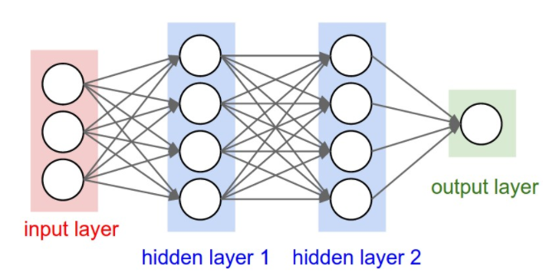
What is Deep Learning^{1,2,4}
The layered DAG describes how a set of functions are composed together. For example, below three are three (parametric) functions f ₁ , f ₂, and f ₂ connected in a chain, to form:
f (x) = f ₃(f ₂(f ₁(x)))

Slide 7
What is Deep Learning^{1,4}
  In deep learning the number layers in the DAG is usually very large

Slide 8
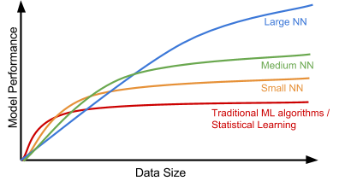
What is Deep Learning⁵

Slide 9
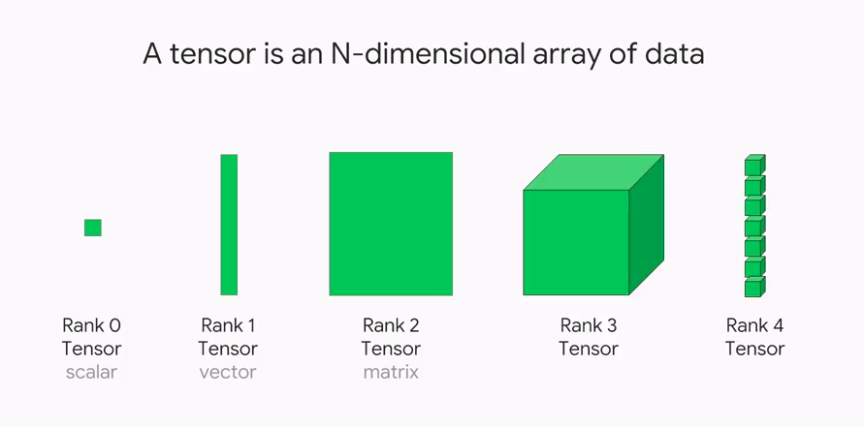
Tensors: Data Structures for Deep Learning²
  A tensor is a (1) container which can house data in N dimensions, and (2) a set of (linear) operations. In DL tensors are used in place of scalars, vectors, matrices and n-dimensional arrays for data representation.

Slide 10
Tensors: Data Structures for Deep Learning⁸
Key attributes of tensors
  Name
  Rank → number of axes
  Shape → number of elements in each dimension
  Data Type
1 | 2 | 3 | 4
5 | 4 | 3 | 2
4 | 3 | 6 | 7
5 | 6 | 2 | 7
Tensor A of Integer Type, Rank 2 and Shape (4,5)
Notes:
So Tensors unify, scalars, vectors, matrix and multidimensional arrays, so that in DL we only manipulate tensors as opposed to different containers

Slide 11
Real world examples of tensors⁸
Stock prices : for every minute, we store the current price of the stock, the highest price in the past minute, and the lowest price in the past minute → an entire trading day can be stored in a tensor of shape (390, 3)
Images : typically have 3 dimensions: height, width, and color depth
  128 grayscale images of size 256 × 256 can be stored in a tensor of shape (128, 256, 256, 1)
  128 color images f size 256 × 256 can be stored in a tensor of shape (128, 256, 256, 3)
Video data: A video is as a sequence of frames, each frame being a color image →a set of different videos can be stored in a 5D tensor of shape (number_of_videos, number_of_frames, height, width, color_depth).

Slide 12
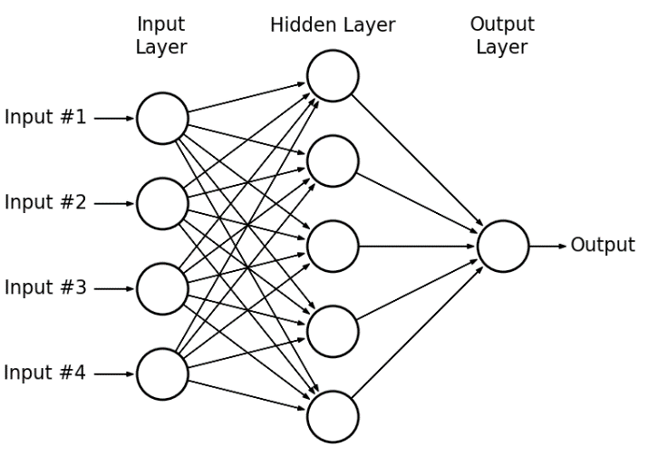
Multilayer Perceptrons (MLPs)^{2,9}
  Also known as feedforward neural networks, are the quintessential deep learning models. An MLP consists of perceptrons stacked together in several layers.
Notes:
And each node in one layer is sending its output to all the nodes in the next layer

Slide 13
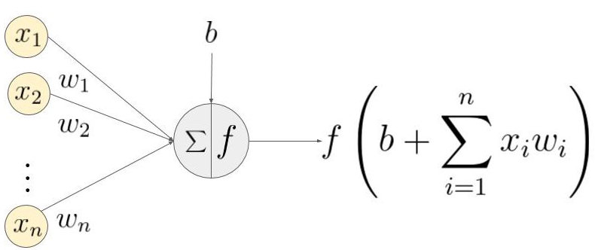
Multilayer Perceptrons (MLPs)^{2,9,12}
Perceptron:
The output is computed by a (sigmoid) activation function and its value is 0 and 1 based on, if the weighted sum ∑ᵢwᵢxᵢ is less than or greater than some threshold value respectively.

Slide 14
Multilayer Perceptrons (MLPs)^{2,9,12}
Perceptron:
The output is computed by a (sigmoid) activation function and its value is 0 and 1 based on, if the weighted sum ∑ᵢwᵢxᵢ is less than or greater than some threshold value respectively.
A bias term can be used to model unobservable factors

Slide 15
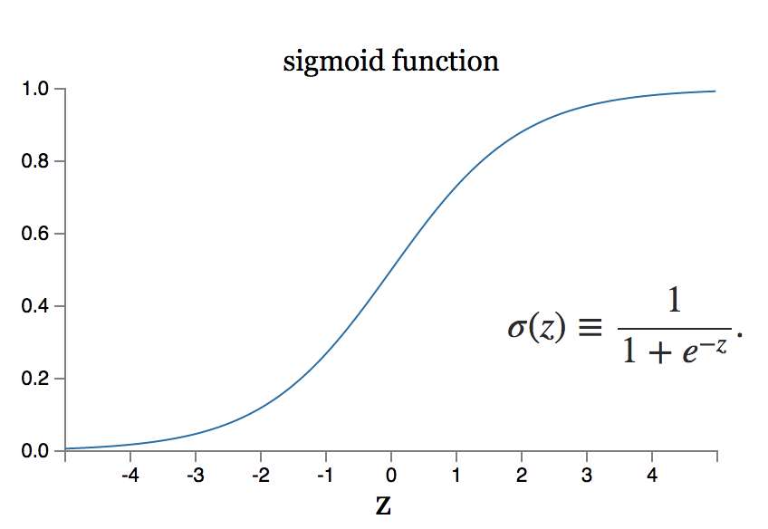
Multilayer Perceptrons (MLPs)¹⁰

Slide 16
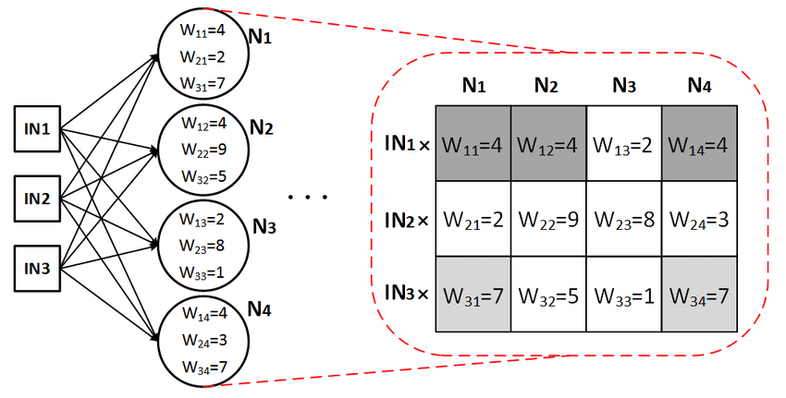
Multilayer Perceptrons (MLPs)¹²
  All the weights of one layer can be represented with matrix

Slide 17
Applications of MLPs
They create competitive predictive models
  E.g., classification of healthcare data¹⁸
MLP layers are present in most deep learning models
They form the basis of many important neural network architectures²
  the convolutional networks used for object recognition from photos are a specialized kind of feedforward network
  feedforward networks are a conceptual steppingstone on the path to recurrent networks, which power many natural language applications
  they are the main building block of the transformer network¹⁹

Slide 18
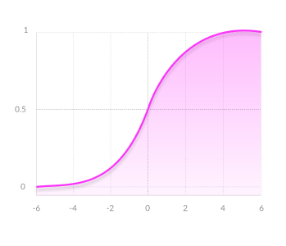
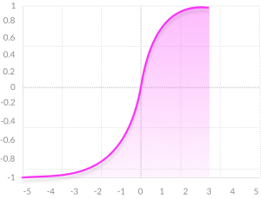
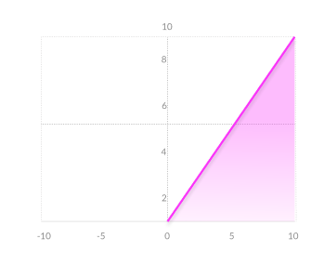
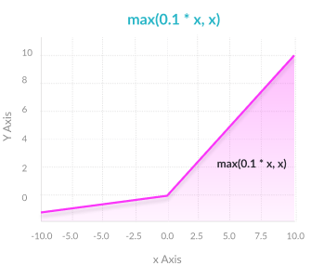
Activation Functions for Deep Learning¹³
Neural networks use non-linear activation functions, which help the network learn complex data, compute and learn almost any function, and provide accurate predictions. Popular activation function include:
  Sigmoid/logistic
  Tanh/Hyperbolic Tangent
  Rectified Linear Unit (ReLU)
  Leaky ReLU
  Sofmax : used for multiple classes
  More recent: ELU/GELU
Notes:
Properties: non linearity, monotonicity, range, Continuously differentiable
ELU → competitive / bettwe performance, accuracy, slower to compute
GELO → providing neuron output a higher probabilistic view

Slide 19
Activation Functions for Deep Learning¹³
Properties of Activation Functions
Activation Function | Advantages | Disadvantages
Sigmoid/logistic | Smooth gradient Output values bound Clear predictions | Vanishing gradient Outputs not zero centered Computationally expensive
Tanh/Hyperbolic Tangent | Zero centered output Otherwise, similar to Sigmoid | Similar to Sigmoid
Rectified Linear Unit (ReLU) | Computationally Efficient | Dying ReLU problem
Leaku ReLU | Prevents dying ReLU problem | Results not consistent
Notes:
The Dying ReLU problem—when inputs approach zero, or are negative, the gradient of the function becomes zero, the network cannot perform backpropagation and cannot learn

Slide 20
Activation Functions for Deep Learning²⁰
Choosing an activation function
  ReLU function is a general activation function and is used in most cases these days
  If we encounter cases of dead neurons in the network the leaky ReLU function is the best choice
  Sigmoid functions and their combinations generally work better in the case of (binary) classifiers
  Sigmoid and tanh functions are sometimes avoided due to the vanishing gradient problem
  As a rule of thumb, one can begin with using ReLU function and then move over to other activation functions in case ReLU doesn’t provide with optimum results

Slide 21


Model Training in Deep Learning²
  Model training involves determining the best set of weights for maximizing a model’s accuracy for a particular task. It entails:
    Defining a suitable loss function, e.g.:
      Mean Square Error, Quadratic loss, L2 Loss:
      Cross entropy loss:
    Computing (finding) minimum of this loss function
Notes:
Loss functions measure how far an estimated value is from its true value. A loss function maps decisions to their associated costs
Cross entropy quantifies the different between the prediction and training data distributions

Slide 22
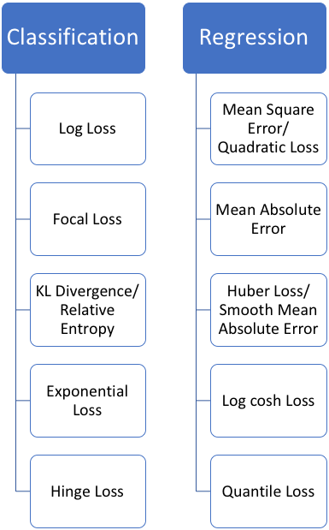
Model Training in Deep Learning²
  Popular Loss Functions²¹

Slide 23
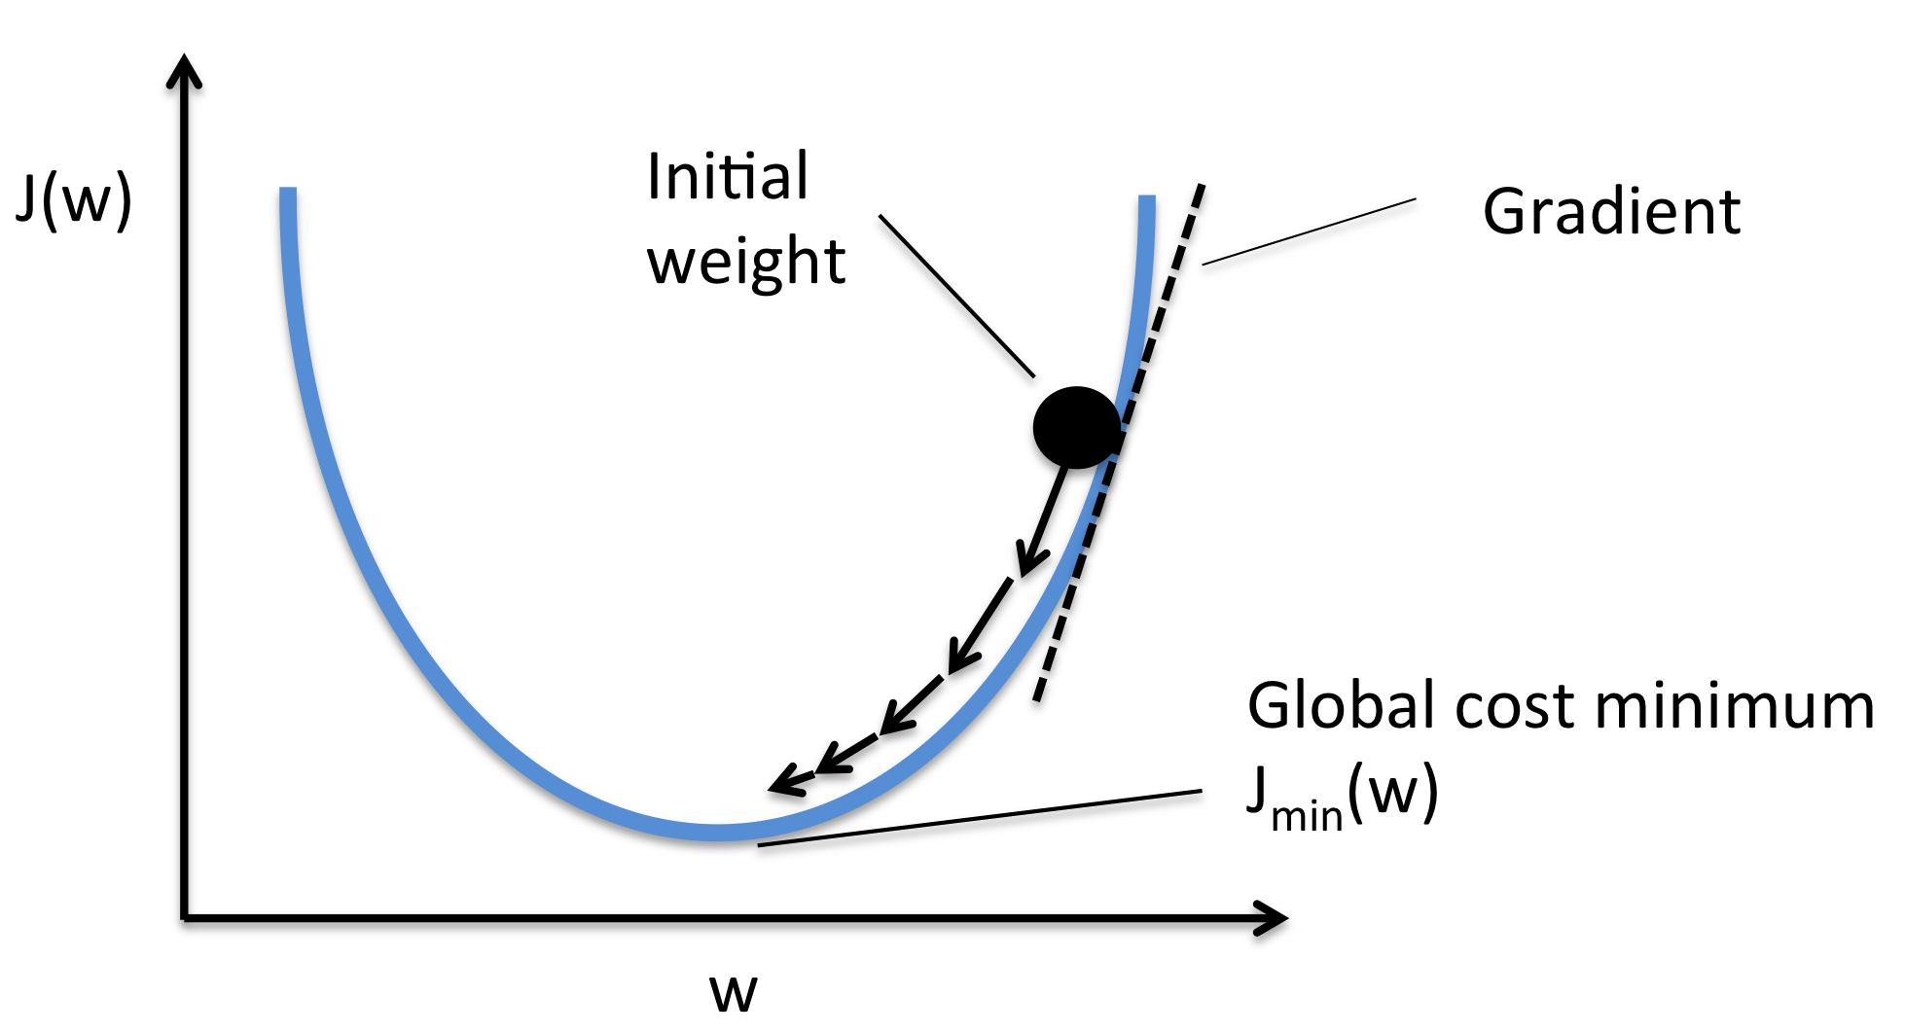
Model Training in Deep Learning²
  The primary technique to train deep learning models is (variations of) gradient descend
    Stochastic (SGD), batch, mini-batch
    Momentum
    Adaptive methods (e.g., AdaGrad, RMSProp, Adam)

Slide 24
Model Training in Deep Learning²
  The primary technique to train deep learning models is (variations of) gradient descend
    Stochastic (SGD), batch, mini-batch
    Momentum
    Adaptive methods (e.g., AdaGrad, RMSProp, Adam)
    The learning rate is the amount that the weights are updated during training

Slide 25
Model Training in Deep Learning²
  Backpropagation is employed to efficiently compute the gradient of the loss function
    need to compute the partial derivatives ∂L/∂w and ∂L/∂b of the cost function L with respect to any weight w or bias b in the network

Slide 26
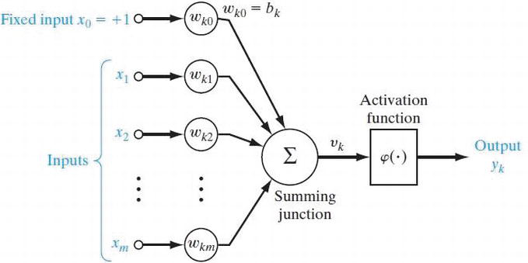
Model Training in Deep Learning^{2,14}
  Backpropagation : View NNs as computational graphs

Slide 27
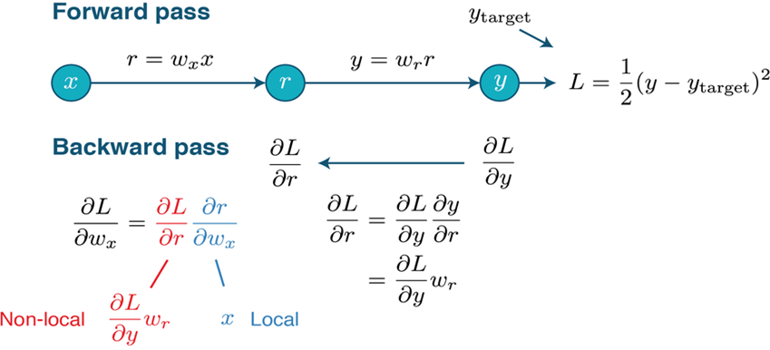
Model Training in Deep Learning^{2,14}
  Backpropagation:
  Forward pass to compute error (loss function value)
  +
  Backward pass to compute error gradient

Slide 28
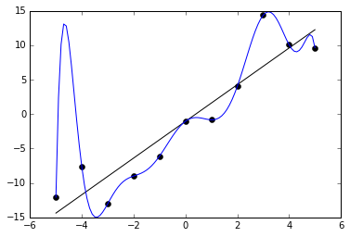
Regularization for Deep Learning^{2,15}
  Because of the large number of parameters DL models are prune to overfitting. Overfitting describes the situation where a model is over-optimized to accurately predict the training set, at the expense of generalizing to unknown data.

Slide 29
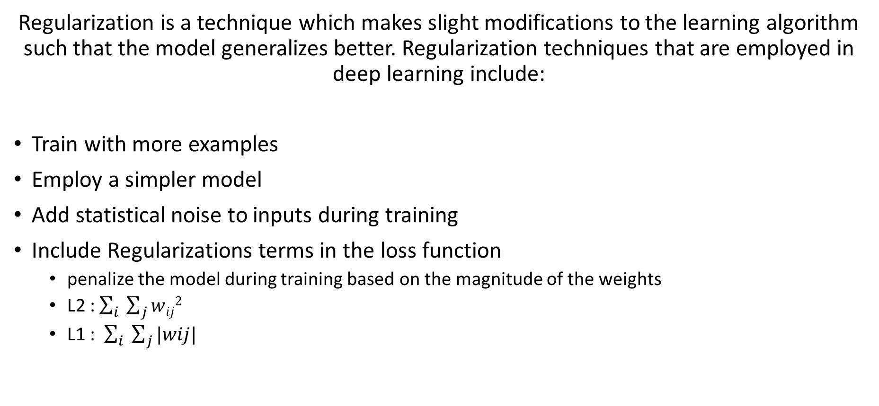
Regularization for Deep Learning^{2,16}
Regularization is a technique which makes slight modifications to the learning algorithm such that the model generalizes better. Regularization techniques that are employed in deep learning include:
Train with more examples
Employ a simpler model
Add statistical noise to inputs during training
Include Regularizations terms in the loss function
  penalize the model during training based on the magnitude of the weights
  L2 : $\sum_{i}{ \sum_{j}{wij2}}$
  L1 : $\sum_{i}{ \sum_{j}{|wij|}}$

Slide 30
Regularization for Deep Learning^{2,16}
Regularization is a technique which makes slight modifications to the learning algorithm such that the model generalizes better. Regularization techniques that are employed in deep learning include:
Dropout
  probabilistically remove inputs during training
Early Stopping
  monitor model performance on a validation set and stop training when performance degrades
Batch Normalization
  normalization step that, at each mini-batch, fixes the means and variances of each layer's inputs
Notes:
Batch normalization accelerates training, in some cases by halving the epochs or better, and provides some regularization, reducing generalization error

Slide 31
Deep Learning Toolkits and Libraries
  scikit-learn: https://scikit-learn.org/stable/modules/generated/sklearn.neural_network.MLPClassifier.html
  TensorFlow/Keras: Dense Layer https://keras.io/api/layers/core_layers/dense/
  Pytorch: Linear + Activation Layers https://medium.com/@tomgrek/building-your-first-neural-net-from-scratch-with-pytorch-56b0e9c84d54
  Sonnet: https://deepmind.com/research/open-source/deepmind-sonnet
  MXNET: https://mxnet.apache.org/versions/1.7.0/
  Swift: https://www.tensorflow.org/swift
  Gluon: https://mxnet.apache.org/versions/1.7.0/api/python/docs/tutorials/packages/gluon/index.html
  DL4J: https://deeplearning4j.org/
  ONNX: https://onnx.ai/
  Chainer: https://chainer.org/

Slide 32
Hands-on MLP-based prediction example

Slide 33
References
https://machinelearningmastery.com/what-is-deep-learning/
I. GoodFellow, Y. Bengio, A. Courniville (2016): Deep Learning (Adaptive Computation and Machine Learning series)
https://en.wikipedia.org/wiki/Deep_learning
https://lilianweng.github.io/lil-log/2017/06/21/an-overview-of-deep-learning.html#why-does-deep-learning-work-now
https://www.youtube.com/watch?v=F1ka6a13S9I&feature=youtu.be
Y. Bengio, A. Courville and P. Vincent, “Representation Learning: A Review and New Perspectives”, in IEEE Transactions on Pattern Analysis and Machine Intelligence, vol. 35, no. 8, pp. 1798-1828, Aug. 2013
https://medium.com/mlait/tensors-representation-of-data-in-neural-networks-bbe8a711b93b
https://medium.com/mlait/tensors-representation-of-data-in-neural-networks-bbe8a711b93b
https://www.researchgate.net/figure/A-hypothetical-example-of-Multilayer-Perceptron-Network_fig4_303875065
https://missinglink.ai/guides/neural-network-concepts/perceptrons-and-multi-layer-perceptrons-the-artificial-neuron-at-the-core-of-deep-learning/#:~:text=4.,of%20the%20perceptron%20learning%20model
https://towardsdatascience.com/deep-learning-feedforward-neural-network-26a6705dbdc7
https://medium.com/coinmonks/the-mathematics-of-neural-network-60a112dd3e05
https://missinglink.ai/guides/neural-network-concepts/7-types-neural-network-activation-functions-right/
https://www.intechopen.com/books/digital-systems/neural-network-principles-and-applications
https://en.wikipedia.org/wiki/Overfitting
https://machinelearningmastery.com/introduction-to-regularization-to-reduce-overfitting-and-improve-generalization-error/
https://machinelearningmastery.com/batch-normalization-for-training-of-deep-neural-networks/
P. Naraei, A. Abhari and A. Sadeghian, "Application of multilayer perceptron neural networks and support vector machines in classification of healthcare data," 2016 Future Technologies Conference (FTC), San Francisco, CA, 2016, pp. 848-852
A. Vaswani, N.Shazer, N. Parmar, J. Usktoreit, L. Jones, A.N. Gomez, L. Kaiser and I. Pushkin, “Attention is all you need”, NIPS 2017
https://www.analyticsvidhya.com/blog/2020/01/fundamentals-deep-learning-activation-functions-when-to-use-them/
https://heartbeat.fritz.ai/5-regression-loss-functions-all-machine-learners-should-know-4fb140e9d4b0

