Slide 1
Convolutional Neural Networks
An overview and applications

Slide 2
Outline
Overview of Convolutional Neural Networks
The Convolution operation
A typical CNN model architecture
Properties of CNN models
Applications of CNN models
Notable CNN models
Limitations of pure CNN models
Hands-on CNN-supported image classification

Slide 3
Convolutional Neural Networks¹
  Convolutional Neural Networks (CNNs) are neural networks that use convolution in place of general matrix multiplication in at least one of their layers
  they are usually employed for processing data that has a grid-like topology
    image data → each image can be thought as a 2D grid of pixels
    timeseries data → each timeseries can be thought as a 1D grid taking samples at regular time intervals

Slide 4
The Convolution operation¹
Assume a 6x6 matrix M as input. The 2D convolution of M with filter (or kernel) F and stride 1 is a 4x4 matrix CM (sometimes called feature map) computed as follows:
3 | 0 | 1 | 2 | 4 | 7
1 | 5 | 8 | 9 | 3 | 1
2 | 7 | 2 | 5 | 1 | 3
0 | 1 | 3 | 1 | 7 | 8
4 | 2 | 1 | 6 | 2 | 8
2 | 4 | 5 | 2 | 3 | 9
1 | 0 | -1
1 | 0 | -1
1 | 0 | -1
=
*
F
CM
M
convolution operator

Slide 5
The Convolution operation¹
Assume a 6x6 matrix M as input. The 2D convolution of M with filter (or kernel) F and stride 1 is a 4x4 matrix CM (sometimes called feature map) computed as follows:
3 | 0 | 1 | 2 | 4 | 7
1 | 5 | 8 | 9 | 3 | 1
2 | 7 | 2 | 5 | 1 | 3
0 | 1 | 3 | 1 | 7 | 8
4 | 2 | 1 | 6 | 2 | 8
2 | 4 | 5 | 2 | 3 | 9
-5
1 | 0 | -1
1 | 0 | -1
1 | 0 | -1
=
*
F
CM
M
3*1 + 1*1 + 2*1 + 0*0 + 5*0 + 7*0 + 1*(-1) + 8*(-1) + 2*(-1)

Slide 6
The Convolution operation¹
Assume a 6x6 matrix M as input. The 2D convolution of M with filter (or kernel) F and stride 1 is a 4x4 matrix CM (sometimes called feature map) computed as follows:
3 | 0 | 1 | 2 | 4 | 7
1 | 5 | 8 | 9 | 3 | 1
2 | 7 | 2 | 5 | 1 | 3
0 | 1 | 3 | 1 | 7 | 8
4 | 2 | 1 | 6 | 2 | 8
2 | 4 | 5 | 2 | 3 | 9
-5 | -4
1 | 0 | -1
1 | 0 | -1
1 | 0 | -1
=
*
F
CM
M
0*1 + 5*1 + 7*1 + 1*0 + 8*0 + 2*0 + 2*(-1) + 9*(-1) + 5*(-1)

Slide 7
The Convolution operation¹
Assume a 6x6 matrix M as input. The 2D convolution of M with filter (or kernel) F and stride 1 is a 4x4 matrix CM (sometimes called feature map) computed as follows:
3 | 0 | 1 | 2 | 4 | 7
1 | 5 | 8 | 9 | 3 | 1
2 | 7 | 2 | 5 | 1 | 3
0 | 1 | 3 | 1 | 7 | 8
4 | 2 | 1 | 6 | 2 | 8
2 | 4 | 5 | 2 | 3 | 9
-5 | -4 | 0
1 | 0 | -1
1 | 0 | -1
1 | 0 | -1
=
*
F
CM
M
1*1 + 8*1 + 2*1 + 2*0 + 9*0 + 5*0 + 4*(-1) + 3*(-1) + 1*(-1)

Slide 8
The Convolution operation¹
Assume a 6x6 matrix M as input. The 2D convolution of M with filter (or kernel) F and stride 1 is a 4x4 matrix CM (sometimes called feature map) computed as follows:
3 | 0 | 1 | 2 | 4 | 7
1 | 5 | 8 | 9 | 3 | 1
2 | 7 | 2 | 5 | 1 | 3
0 | 1 | 3 | 1 | 7 | 8
4 | 2 | 1 | 6 | 2 | 8
2 | 4 | 5 | 2 | 3 | 9
-5 | -4 | 0 | 8
1 | 0 | -1
1 | 0 | -1
1 | 0 | -1
=
*
F
CM
M
2*1 + 9*1 + 5*1 + 4*0 + 3*0 + 1*0 + 7*(-1) + 1*(-1) + 3*(-1)

Slide 9
The Convolution operation¹
Assume a 6x6 matrix M as input. The 2D convolution of M with filter (or kernel) F and stride 1 is a 4x4 matrix CM (sometimes called feature map) computed as follows:
3 | 0 | 1 | 2 | 4 | 7
1 | 5 | 8 | 9 | 3 | 1
2 | 7 | 2 | 5 | 1 | 3
0 | 1 | 3 | 1 | 7 | 8
4 | 2 | 1 | 6 | 2 | 8
2 | 4 | 5 | 2 | 3 | 9
-5 | -4 | 0 | 8
-10
1 | 0 | -1
1 | 0 | -1
1 | 0 | -1
=
*
F
CM
M
1*1 + 2*1 + 0*1 + 5*0 + 7*0 + 1*0 + 8*(-1) + 2*(-1) + 3*(-1)

Slide 10
The Convolution operation¹
Assume a 6x6 matrix M as input. The 2D convolution of M with filter (or kernel) F and stride 1 is a 4x4 matrix CM (sometimes called feature map) computed as follows:
3 | 0 | 1 | 2 | 4 | 7
1 | 5 | 8 | 9 | 3 | 1
2 | 7 | 2 | 5 | 1 | 3
0 | 1 | 3 | 1 | 7 | 8
4 | 2 | 1 | 6 | 2 | 8
2 | 4 | 5 | 2 | 3 | 9
-5 | -4 | 0 | 8
-10 | -2
1 | 0 | -1
1 | 0 | -1
1 | 0 | -1
=
*
F
CM
M
5*1 + 7*1 + 1*1 + 8*0 + 2*0 + 3*0 + 9*(-1) + 5*(-1) + 1*(-1)

Slide 11
The Convolution operation¹
Assume a 6x6 matrix M as input. The 2D convolution of M with filter (or kernel) F and stride 1 is a 4x4 matrix CM (sometimes called feature map) computed as follows:
3 | 0 | 1 | 2 | 4 | 7
1 | 5 | 8 | 9 | 3 | 1
2 | 7 | 2 | 5 | 1 | 3
0 | 1 | 3 | 1 | 7 | 8
4 | 2 | 1 | 6 | 2 | 8
2 | 4 | 5 | 2 | 3 | 9
-5 | -4 | 0 | 8
-10 | -2 | 2 | 3
0 | -2 | -4 | -7
-3 | -2 | -3 | -16
1 | 0 | -1
1 | 0 | -1
1 | 0 | -1
=
*
F
CM
M
1*1 + 6*1 + 2*1 + 7*0 + 2*0 + 3*0 + 8*(-1) + 8*(-1) + 9*(-1)

Slide 12
Larger Strides
Assume a M, a 7x7 matrix. The 2D convolution of M with filter F and stride 2 is a 3x3 matrix CM computed as follows:
2 | 3 | 7 | 4 | 6 | 2 | 9
6 | 6 | 9 | 8 | 7 | 4 | 3
3 | 4 | 8 | 3 | 8 | 9 | 7
7 | 8 | 3 | 6 | 6 | 3 | 4
4 | 2 | 1 | 8 | 3 | 4 | 6
3 | 2 | 4 | 1 | 9 | 8 | 3
0 | 1 | 3 | 9 | 2 | 1 | 4
3 | 4 | 4
1 | 0 | 2
-1 | 0 | 3
=
91
*
F
CM
M
2*3 + 6*1 + 3*(-1) + 3*4 + 6*0 + 4*0 + 7*4 + 9*2 + 8*3

Slide 13
Larger Strides
Assume a M, a 7x7 matrix. The 2D convolution of M with filter F and stride 2 is a 3x3 matrix CM computed as follows:
2 | 3 | 7 | 4 | 6 | 2 | 9
6 | 6 | 9 | 8 | 7 | 4 | 3
3 | 4 | 8 | 3 | 8 | 9 | 7
7 | 8 | 3 | 6 | 6 | 3 | 4
4 | 2 | 1 | 8 | 3 | 4 | 6
3 | 2 | 4 | 1 | 9 | 8 | 3
0 | 1 | 3 | 9 | 2 | 1 | 4
3 | 4 | 4
1 | 0 | 2
-1 | 0 | 3
=
91 | 100
*
F
CM
M
7*3 + 9*1 + 8*(-1) + 4*4 + 8*0 + 3*0 + 6*4 + 7*2 + 8*3

Slide 14
Larger Strides
Assume a M, a 7x7 matrix. The 2D convolution of M with filter F and stride 2 is a 3x3 matrix CM computed as follows:
2 | 3 | 7 | 4 | 6 | 2 | 9
6 | 6 | 9 | 8 | 7 | 4 | 3
3 | 4 | 8 | 3 | 8 | 9 | 7
7 | 8 | 3 | 6 | 6 | 3 | 4
4 | 2 | 1 | 8 | 3 | 4 | 6
3 | 2 | 4 | 1 | 9 | 8 | 3
0 | 1 | 3 | 9 | 2 | 1 | 4
3 | 4 | 4
1 | 0 | 2
-1 | 0 | 3
=
91 | 100 | 88
*
F
CM
M
6*3 + 7*1 + 8*(-1) + 2*4 + 4*0 + 9*0 + 9*4 + 3*2 + 7*3

Slide 15
Larger Strides
Assume a M, a 7x7 matrix. The 2D convolution of M with filter F and stride 2 is a 3x3 matrix CM computed as follows:
2 | 3 | 7 | 4 | 6 | 2 | 9
6 | 6 | 9 | 8 | 7 | 4 | 3
3 | 4 | 8 | 3 | 8 | 9 | 7
7 | 8 | 3 | 6 | 6 | 3 | 4
4 | 2 | 1 | 8 | 3 | 4 | 6
3 | 2 | 4 | 1 | 9 | 8 | 3
0 | 1 | 3 | 9 | 2 | 1 | 4
3 | 4 | 4
1 | 0 | 2
-1 | 0 | 3
=
91 | 100 | 88
57
*
F
CM
M
3*3 + 7*1 + 4*(-1) + 4*4 + 8*0 + 2*0 + 8*4 + 3*2 + 1*3

Slide 16
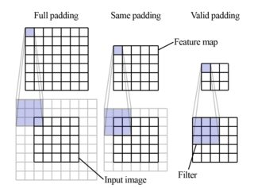
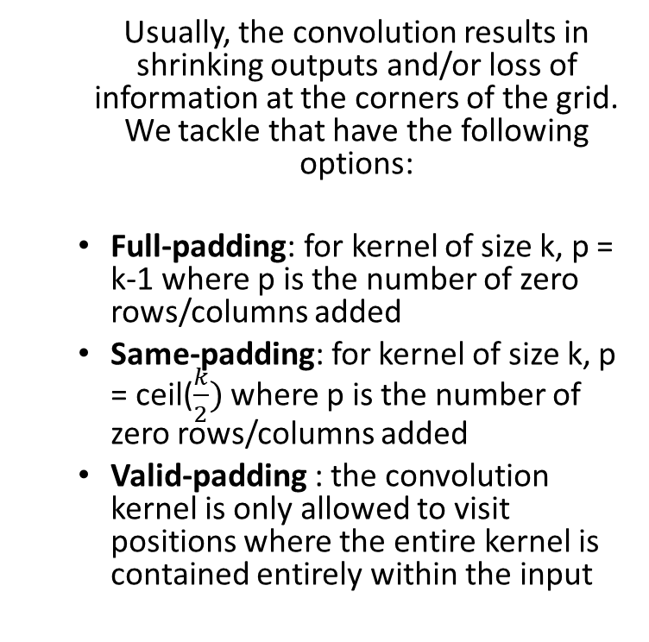
Padding^{1,4}
  Usually, the convolution results in shrinking outputs and/or loss of information at the corners of the grid. We tackle that have the following options:
  Full-padding: for kernel of size k, p = k-1 where p is the number of zero rows/columns added
  Same-padding: for kernel of size k, p = ceil($\frac{k}{2})$ where p is the number of zero rows/columns added
  Valid-padding : the convolution kernel is only allowed to visit positions where the entire kernel is contained entirely within the input

Slide 17
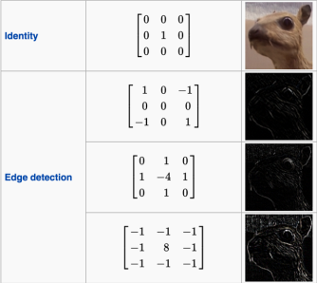
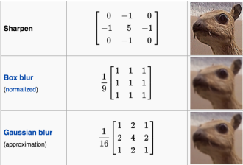
The Convolution operation on Images³
Convolutions are frequently used in image processing, to manipulate the image or detect different features in the image

Slide 18
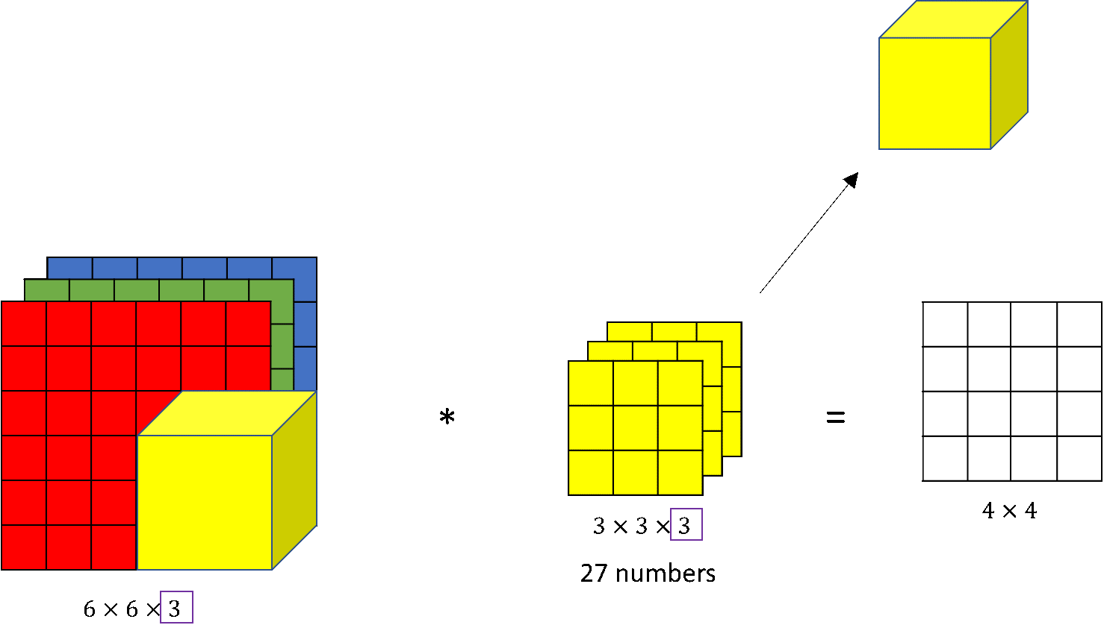
The Convolution operation on RBG Images⁵
An RGB image is represented with a 3D tensor: (x, y, 3), where x, y are the pixel dimensions and 3 corresponds to the 3 color channels. The filter will also be 3 channels.

Slide 19
The Convolution operation on RBG Images⁵
  The channel dimension in the kernel permits to detect features in only a subset of the dimensions, e.g.
  vertical edges only in the red dimension
    set all cells in the blue and green channels to zero
  horizontal edges in the red and blue dimensions
  vertical edges no matter the color dimension

Slide 20
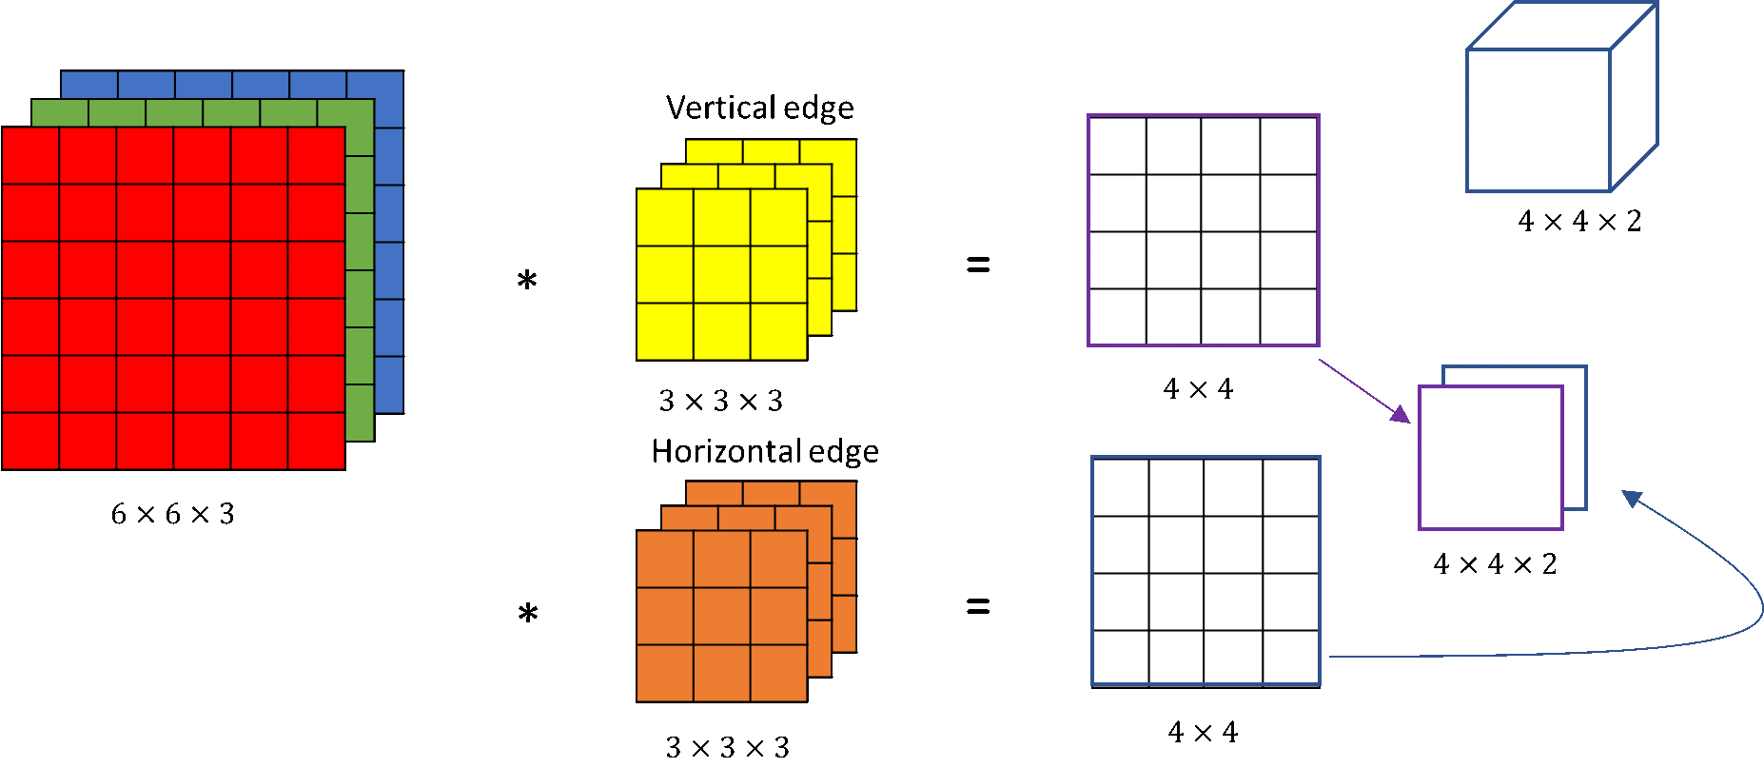
The Convolution operation on RBG Images⁵
  We can also detect different features at the same time, by employing multiple filters
  The output will have a number of channels equal to the number of features we are trying to detect

Slide 21
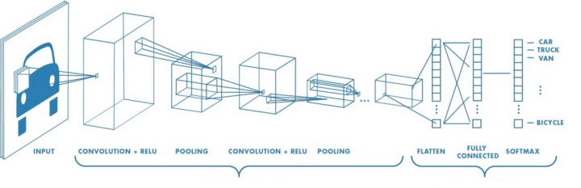
Typical CNN model architecture³
Typically, a CNN model consists of convolution layers, for feature selection, followed by fully connected layers that perform the prediction task
Feature Learning
Prediction Task

Slide 22
Typical CNN model architecture¹
  A typical feature learning layer of a convolutional network consists of three stages:
  the first stage performs several convolution operations in parallel to produce a set of linear activations
    each convolution employs a different kernel to learn different features
    the input is usually a grid of vector-valued observations
  in the second stage, each linear activation is run through a nonlinear activation function (e.g., ReLU)
  In the third stage, a pooling function is employed to modify the output of the layer further

Slide 23
Pooling¹
  A pooling function replaces the output of the net at a certain location with a
  summary statistic of the nearby outputs
  max pooling
  average
  weighted average
  sum
  L2 norm
  pooling helps make the representation become approximately
  invariant to small translations of the input

Slide 24
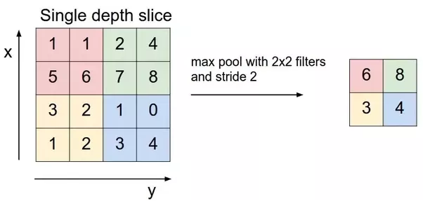
Pooling^{1,3}
Example of max pooling

Slide 25
Properties of CNN models
Sparse interactions between NN units (through kernels of small size)
  fewer parameters to learn
  less computation resources are required
Parameter sharing (same kernel is applied throughout the input)
  Maintain the same feature detection throughout the input
Ability to (automatically) learn local structure
Can handle variable-sized inputs

Slide 26
Applications of CNN models^{6,7}
Image Processing
  image classification
  object detection
  image segmentation
  object tracking
  visual saliency recognition
  face recognition
Histopathology
Speech Processing
Text Detections and Recognition (OCR)

Slide 27
Applications of CNN models^{6,7}
Natural Language Processing
Drug Discovery
Timeseries Analysis
  Health risk assessment and biomarkers of aging discovery
  Forecasting
  Electromyography (EMG) recognition
Go

Slide 28
Notable CNN models^{11, 12}
LeNet
AlexNet
VGG-16
Inception-based architectures
Xception
ResNet

Slide 29
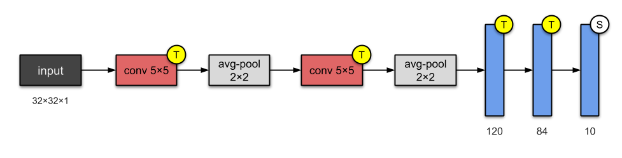
Notable CNN models^{11,12}
LeNet (1998)⁸
The architecture has become the standard ‘template’ architecture:
(1) stacking convolutions and pooling layers (7 levels)
(2) ending the network with one or more fully-connected layers

Slide 30
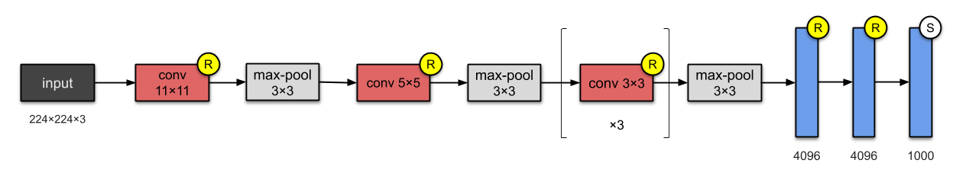
Notable CNN models^{11,12}
AlexNet (2012)⁹
(1) deeper and with more filters than LeNet
(2) employed stacked convolutional layers
(3) was first to implement Rectified Linear Units (ReLUs) as activation functions
→ in 2012 outperformed all prior competitors and won the ImageNet challenge

Slide 31
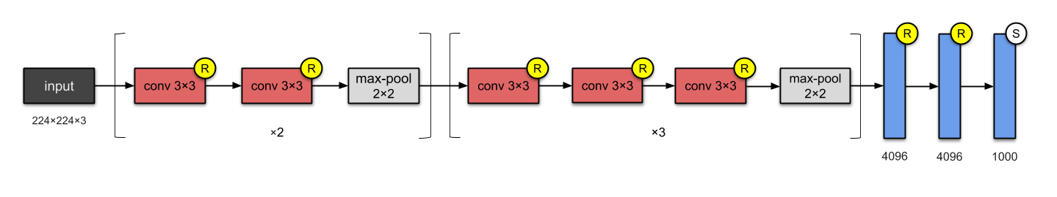
Notable CNN models^{11,12}
VGG-16/VGG-19 (2014)¹⁰
(1) significantly deeper network that the previous ones (16 to 19 layers)
(2) more and smaller filters (3x3)
→ was the runner-up in 2014 ImageNet challenge

Slide 32
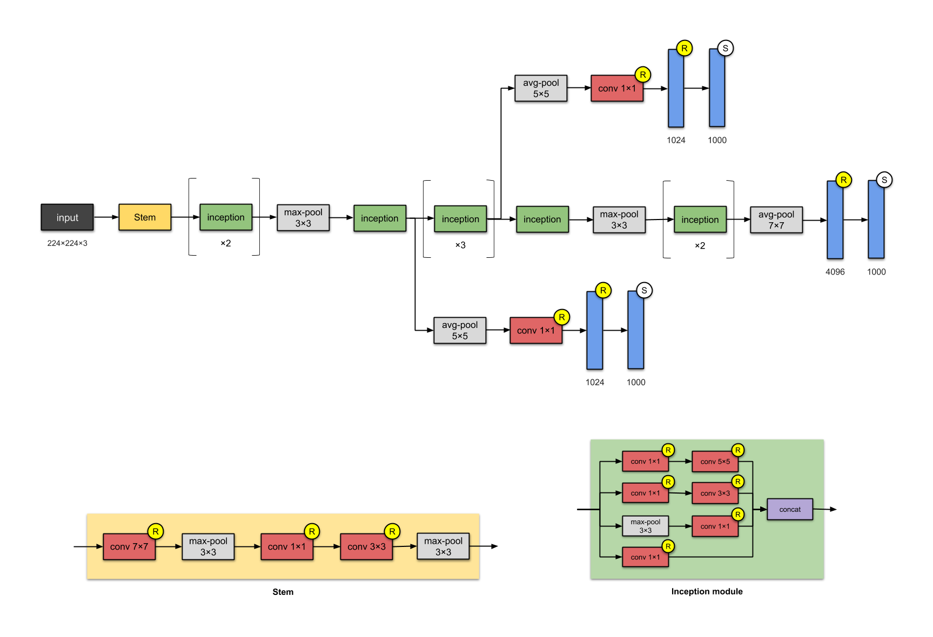
Notable CNN models^{11,12}
GoogleNet/Inception- v1 (2014)¹³
(1) even deeper network (22 layers)
(2) implemented the inception module to drastically reduce the number of parameters
(3) employed batch normalization
→ was the winner in 2014 ImageNet challenge

Slide 33
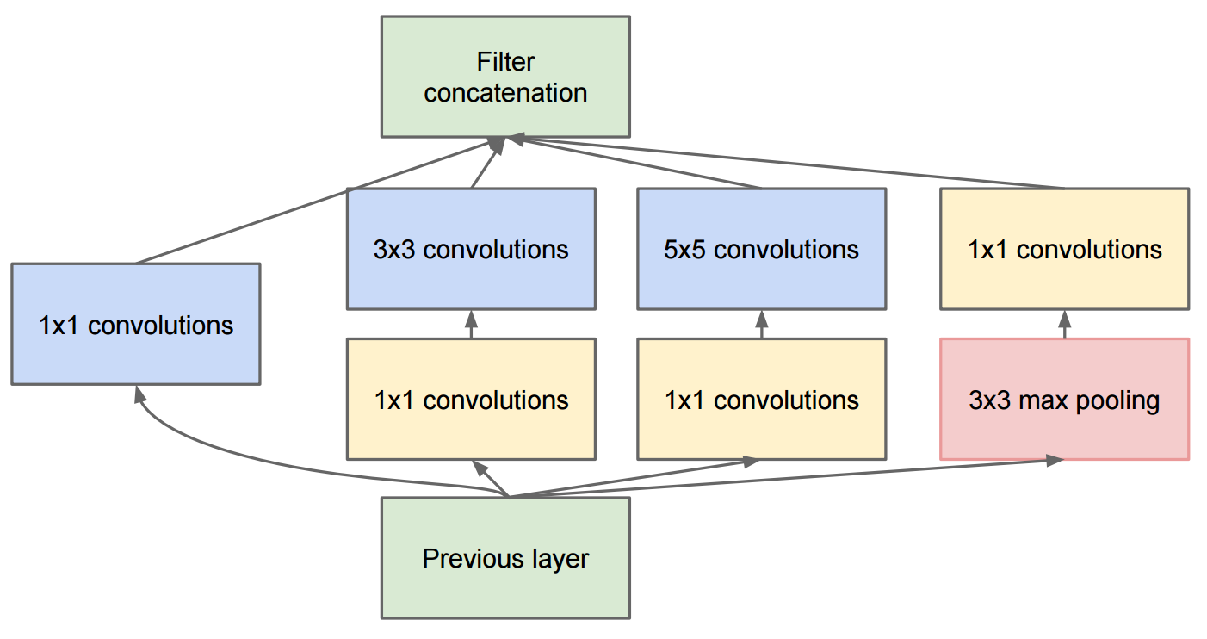
Notable CNN models^{11,12}
Inception- 1 module
Enhancements of the original inception module (e.g., Inception- v3¹⁴, Inception- v4¹⁸ ) have improved the performance of the inception-supported models, most notably by refactoring larger convolutions into consecutive smaller ones that are easier to learn

Slide 34
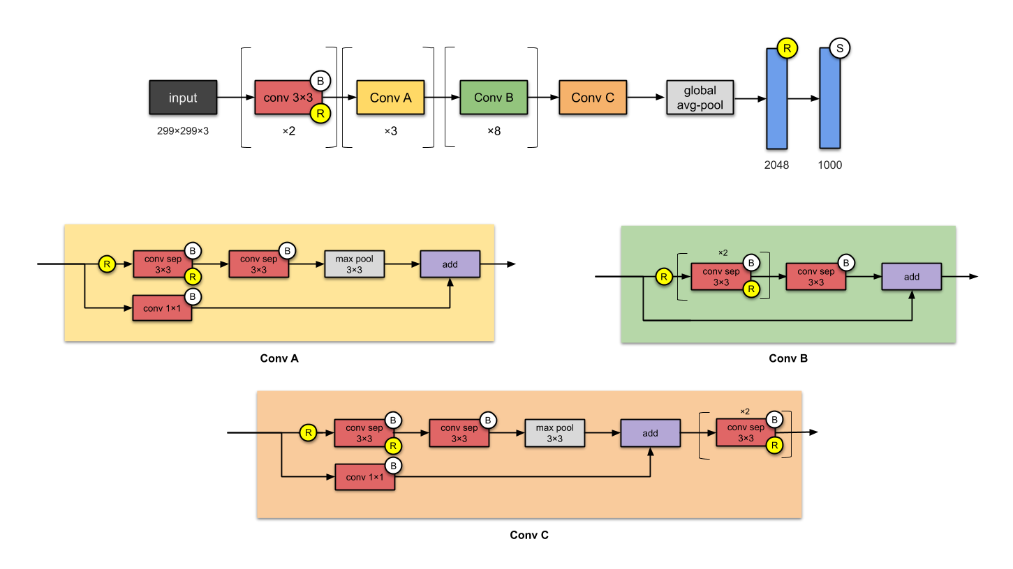
Notable CNN models^{11,12}
Xception (2016)¹⁶
(1) inception modules are replaced with depth-wise separable convolutions
(2) same number of parameters as Inception
→ slightly outperforms Inception v3 on the ImageNet dataset, and vastly outperforms it on a larger image classification dataset with 17,000 classes
Notes:
its architecture is powering Google’s mobile vision applications through MobileNet.

Slide 35
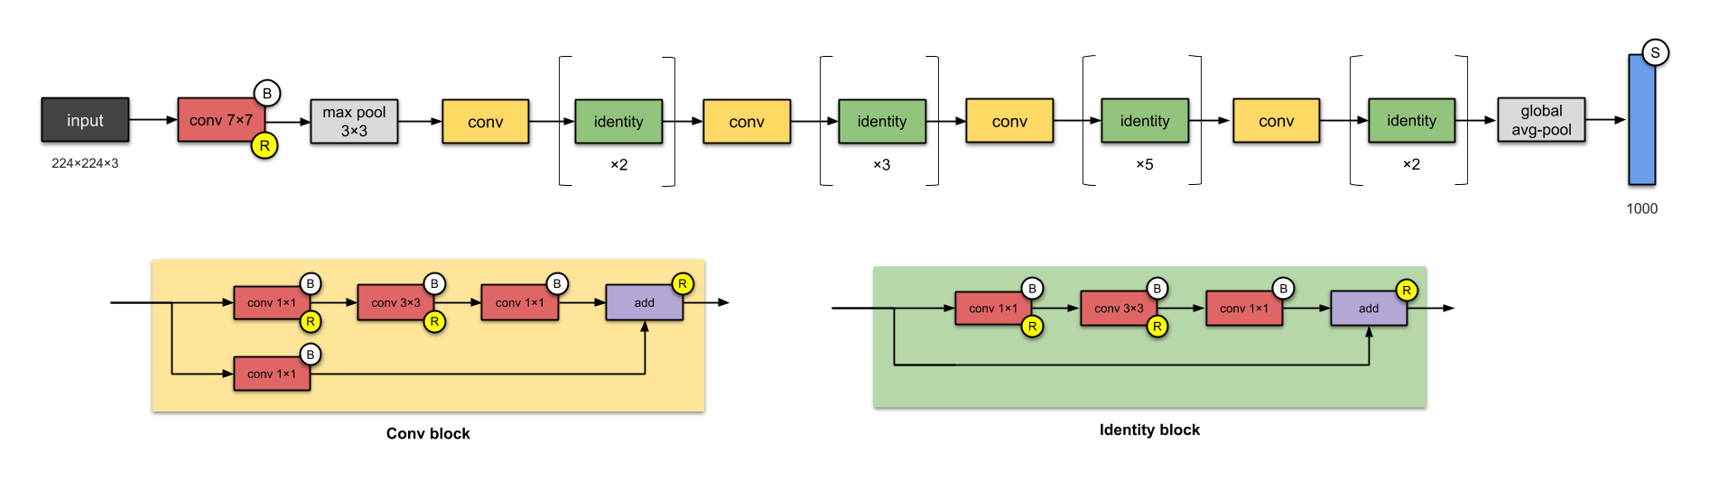
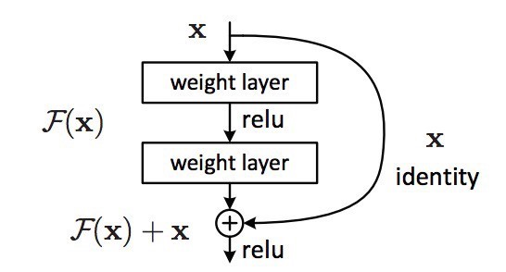
Notable CNN models^{11,12}
Resnet (2015)¹⁵
(1) instead of learning a mapping from x to H(x), learn the difference F(x) = H(x) - x → creates skip connections
(2) skip connections stacked on top of each other
→ enables deeper architectures without loss of performance
Notes:
Hybrids of inception/xception and resnet are ery popular

Slide 36
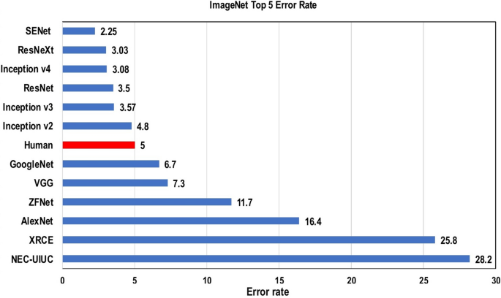
Notable CNN models¹⁹
Notes:
Hybrids of inception/xception and resnet are ery popular

Slide 37
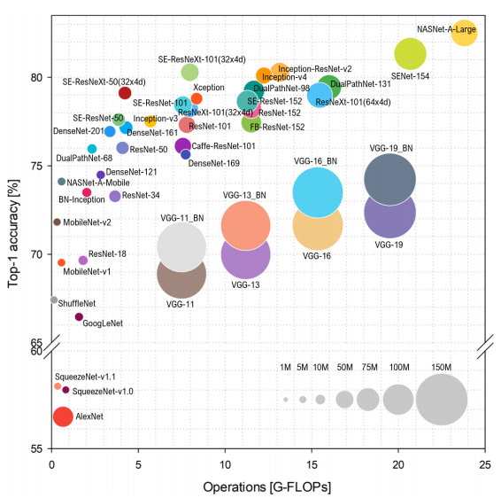
Notable CNN models²⁰

Slide 38
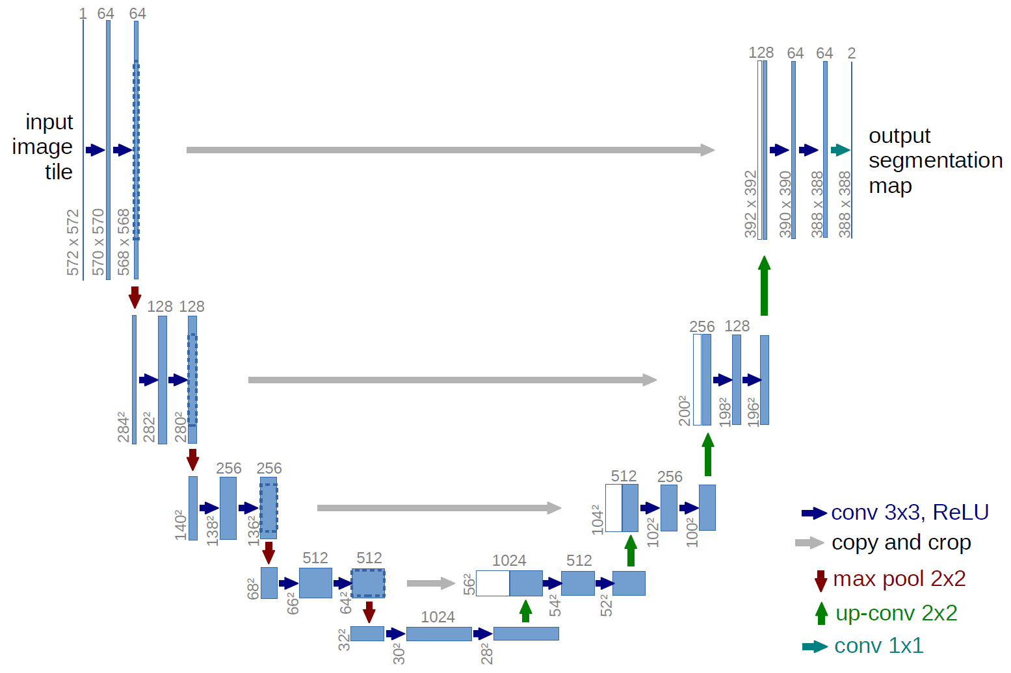
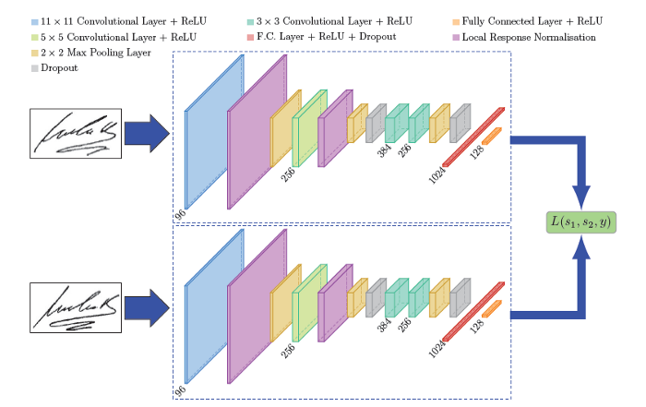
Application Architectures based on CNN models
UNET: semantic segmentation
Siamese Network:
  learns from very little data
Notes:
The key to one-shot learning is an architecture called the “Siamese neural network.”

Slide 39
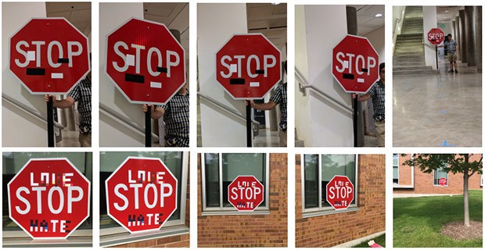
All is great then?²¹
CNN models can be easily fooled
Notes:
Recently in 2020, the cybersecurity firm McAfee showed that Mobileye — the car intelligence system used by Tesla and other auto manufacturers — could be fooled into accelerating 50 MPH over the speed limit just by plastering a strip of black tape two inches wide to a speed limit sign.
Researchers from four universities including the University of Washington and UC Berkeley discovered that road sign recognition models were completely fooled when introduced to a bit of spray paint or stickers on stop signs — all completely natural and non-malicious alterations

Slide 40
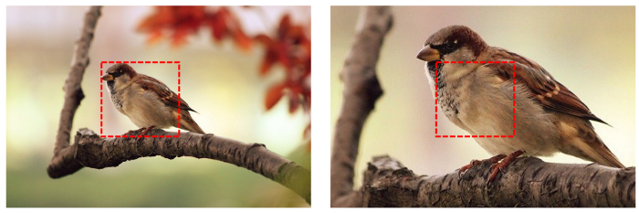
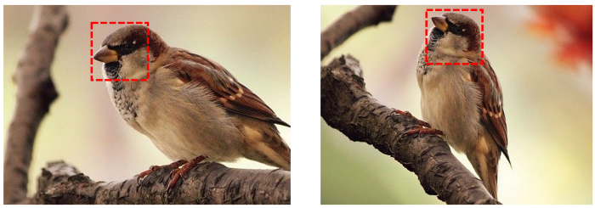
All is great then?²¹
CNNs are bad at generalizing across scaling, shifts and rotations in images, as well as different angles of three-dimensional viewing.
Notes:
Recently in 2020, the cybersecurity firm McAfee showed that Mobileye — the car intelligence system used by Tesla and other auto manufacturers — could be fooled into accelerating 50 MPH over the speed limit just by plastering a strip of black tape two inches wide to a speed limit sign.
Researchers from four universities including the University of Washington and UC Berkeley discovered that road sign recognition models were completely fooled when introduced to a bit of spray paint or stickers on stop signs — all completely natural and non-malicious alterations

Slide 41
Hands-on CNN-supported image classification
https://bitbucket.org/diip20201/tutorials/src/master/cnn/

Slide 42
References
I. GoodFellow, Y. Bengio, A. Courniville: Deep Learning (Adaptive Computation and Machine Learning series), 2016
https://colah.github.io/posts/2014-07-Understanding-Convolutions/2018
https://medium.com/@RaghavPrabhu/understanding-of-convolutional-neural-network-cnn-deep-learning-99760835f148
https://ai.stackexchange.com/questions/17004/convolutional-neural-network-does-each-filter-in-each-convolution-layer-create
http://datahacker.rs/convolution-rgb-image/
https://en.wikipedia.org/wiki/Convolutional_neural_network#Applications
J. Gua, Z. Wang, J. Kuen, L. Ma, A. Shahroudy, B. Shuai, T. Liu, X. Wang, G. Wang, J. Cai, T. Chen: Recent advances in convolutional neural networks, Pattern Recognition, May 2018
Y. LeCun, L. Bottou, Y. Bengio and P. Haffner: Gradient-Based Learning Applied to Document Recognition, Proceedings of the IEEE, 86(11):2278-2324, 1998
A. Krizhevsky, I. Sutskever and G. F Hinton: ImageNet Classification with Deep Convolutional Neural Networks, NIPS 2012
K. Simonyan and A. Zisseman: Very Deep Convolutional Networks for Large-Scale Image Recognition: arXiv preprint, 2014
https://towardsdatascience.com/illustrated-10-cnn-architectures-95d78ace614d
https://medium.com/analytics-vidhya/cnns-architectures-lenet-alexnet-vgg-googlenet-resnet-and-more-666091488df5
C. Szegedy, W. Liu, Y. Jia, P. Sermanet, S. Reed, D. Anguelov, D. Erhan, V. Vanhoucke, A. Rabinovich: Going Deep with Convolutions: CVPR 2015
C. Szegedy, V. Vanhoucke, S. Ioffe, J. Shlens, Z. Wojna: Rethinking the Inception Architecture for Computer Vision: CVPR 2016
K. He, X. Zhang, S. Ren, J. Sun: Deep Residual Learning for Image Recognition : CVPR 2016
F. Chollet: Xeption: Deep Learning with Separable Convolutions : CVPR 2017
O. Ronneberger, P. Fischer and T. Brox: U-Net: Convolutional Networks for Biomedical Image Segmentation: Medical Image Computing and Computer-Assisted Intervention (MICCAI), Springer, LNCS, Vol.9351: 234--241, 2015
C. Szegedy, S. Ioffe, V. Vanhoucke and A. Alemi: Inception-v4, inception-ResNet and the impact of residual connections on learning, AAAI 2017
https://journalofbigdata.springeropen.com/articles/10.1186/s40537-021-00444-8
S Bianco, R. Cadene, L Celona and P Napoletano: Benchmark Analysis of Representative Deep Neural Network Architectures, IEEE Access 6(1) 2018
https://towardsdatascience.com/we-need-to-rethink-convolutional-neural-networks-ccad1ba5dc1c

