Slide 1
Graph Based Data Science
Opportunities, challenges and techniques

Slide 2
Outline
Graphs for Data Representation
Overview of Graph Based Data Science
Graph Analysis Algorithms
Graph Aware ML/AI techniques
  Graph Kernels
  Graph Embeddings
  Graph Neural Networks
Hands-on graph-based ML/AI example

Slide 3
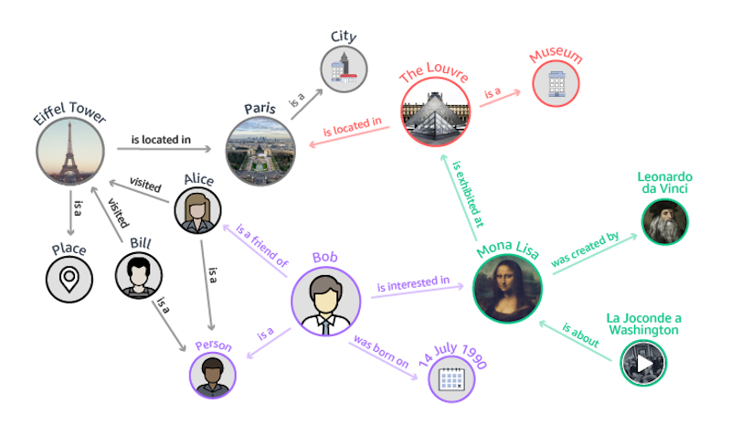
Graphs for Data Representation^{1,2,46}
A data graph is a mathematical representation of entities (nodes) and their relationships (edges).
Why data graphs?
  they represent data intuitively
  they make it easier to explore the data
  a lot of real-world examples are already graph structured**
Notes:
** → more details on subsequent slides

Slide 4
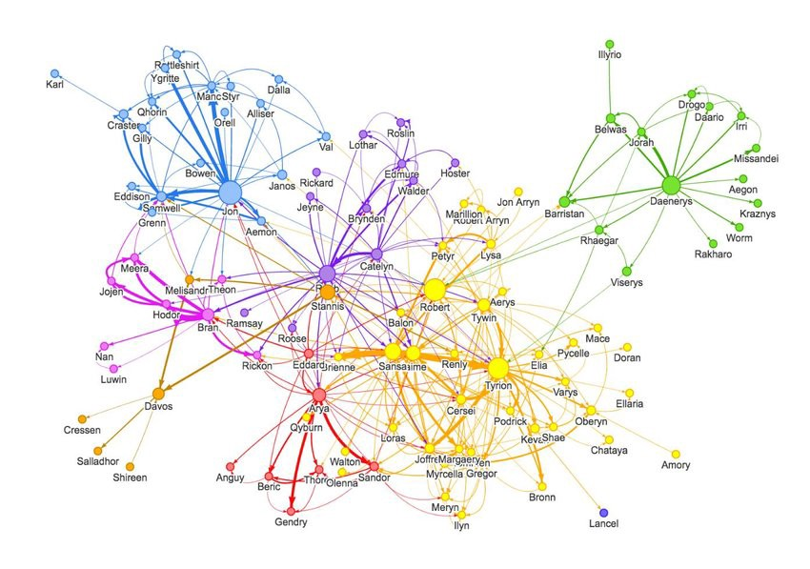
Graphs for Data Representation^{1,2}
Examples of real-world graph data:
  WWW, Internet
  Social Networks
  Citation networks
  Protein interaction networks
  Communication networks
  Word co-occurrences networks
  Food webs
  Financial networks
  Economic networks
  Knowledge graphs
  ……
[55]

Slide 5
Overview of Graph Based Data Science³
  Graph based data science combines querying, statistics and graph algorithms to power ML/AI applications by leveraging the relationships and topology of graph data
  Graph Analytics: uses queries and graph statistics/algorithms** to answer such questions as:
    how many customers are in a marketing graph?
    are there any fraud rings in the transaction data?
    who’s the most important influencer in a network?
  Graph Enhanced ML and AI: uses queries, graph statistics/algorithms and specialized graph aware ML/AI techniques to describe the global topology or connectivity of a data set. The results define graph-based features that are used as input to downstream ML/AI tasks
Notes:
The distinction is mostly for educational/presentational purposes and does not reflect a clear-cut division

Slide 6
Overview of Graph Based Data Science³
Graph Queries: retrieve an explicit pattern within the dataset e.g.
  fetch the names of George’s co-authors
  compute the average salary of a company’s employees
Graph Statistics: are based on local properties of the graph nodes:
  Graph size
  Graph density
  Degree distribution
  Local clustering coefficient
Notes:
Dense vs Sparse graphs
Node degree + number of node neighbors
The local clustering coefficient of a vertex (node) in a graph quantifies how close its neighbours are to being a clique (complete graph).

Slide 7
Overview of Graph Based Data Science³
Graph Algorithms: employ graph traversals
  Connected Components: identify strongly connected subgraphs
  Community Detection: partition a graph based on relationships
  Centrality: reveal which nodes are important based on graph topology
  Node Similarity: identify similar nodes based on their neighbors or properties
  Pathfinding: find the shortest or most efficient paths to traverse a graph
  Link Prediction: predict unobserved or future relationships between nodes**
  Some of the graph algorithms employ ML techniques themselves!

Slide 8
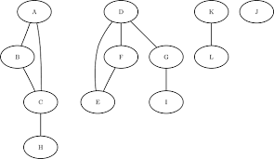
Graph Algorithms
Connected Components⁵
Undirected Graph:
  Breadth First Search
  Depth First Search
Directed Graph:
  Weakly Connected Components: discard edge directions and proceed as before
  Strongly Connected Components: Kosaraju's algorithm⁵⁷
Use Cases
  Image Processing²⁹
  Entity Resolution/deduplication
  Cybersecurity³⁰
  Fraud Detection
  etc.
Notes:
Image processing → Skin Region of Interest

Slide 9
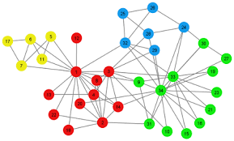
Graph Algorithms
Community Detection¹¹
  Algorithms:
    Louvain⁶
    Label Propagation⁷
    many more⁸
  Use Cases:
    Social networks analysis: e.g., extracting topics from online social platforms⁹
    Criminology: identification of groups in criminal networks
    Public Health: discover dynamics of certain groups susceptible to an epidemic disease
    Customer Segmentation: identify groups of people that are using the same financial service
    Bioinformatics: investigating the human brain and finding hierarchical community structures within the brain’s functional network¹⁰
    etc.
Notes:
Louvain: measures the density of links inside communities compared to links between communities

Slide 10
Graph Algorithms
Node Similarity
  Based on:
  Node’s own features
  Node’s own and neighbors’ ID/features
  Similar neighbors (recursive definition)
  Graph topology
  Any combination of the above
  Use cases:
  Entity matching/resolution³¹
  Recommendations (e.g., ‘Customers who brought this item also brought..’)
  etc.

Slide 11
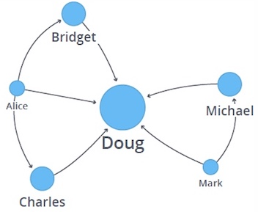
Graph Algorithms
Centrality¹¹
  Variations:
    Degree Centrality: nodes with lots of direct connections
    Closeness Centrality: nodes that can reach other nodes with few hops
    Betweenness Centrality: nodes that sit on the shortest path of lots of pairs of other nodes
    Eigenvector Centrality: nodes that are transitively connected to other important nodes
  Use Cases:
    Identification of social media influencers^{12,13}
    Fighting fraud and terrorism^{14,15,16}
    Predicting flow in traffic, delivery and telecommunications systems^{17,18}
    etc.

Slide 12
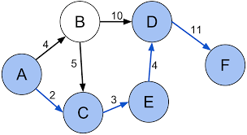
Graph Algorithms
Path Finding⁵
Algorithms
  Shortest Path
  A*
  Yen’s k-shortest paths
  All pairs shortest path
  Single source shortest path
  Minimum Spanning Tree
  Random Walks
Use cases
  Directions between two physical locations
  Degrees of separation between people
  Travel Planning^{20, 21}
  Financial Analysis¹⁹
  Graph Embeddings**
  etc.

Slide 13
Graph Aware ML/AI Techniques

Slide 14
Graph Kernels³²
  Graph Kernels can be intuitively understood as functions quantifying the similarity of pairs of graphs.
Kernel based on shortest paths:
Sim (G₁, G₂) = 0.98
Sim (G₂, G₃) = 0.90
Sim (G₁, G₃) = 0.86
G₁
G₂
G₃

Slide 15
Graph Kernels^{32,33}
What is a graph kernel?
  Map two graphs g₁ and g₂ using mapping φ into feature space Η
  Measure their similarity in Η as <φ(g₁), φ(g₁)>
  Actualize kernel trick: devise kernel function k such k(g₁, g₂) = <φ(g₁), φ(g₁)>
Notes:
<> → inner product

Slide 16
Graph Kernels^{32,33}
Requirement for graph kernel functions:
  Positive definite (in order to be a valid kernel function)
  Expressive
    define a non-trivial measure of similarity on graphs
    represent subgraph features that allow to tell if the topology, node and edge labels of two graphs are similar
  Applicable to a wide range of graphs
  Efficient to compute

Slide 17
Graph Kernels^{32,33}
Graph Kernel variants³⁴: graph kernels take the form of an aggregation over metrics that describe different aspects of the graph topology:
based on local structure: two graphs are similar if they are composed of nodes with similar neighborhoods
graph components: compare graphs by identifying the best possible matching of the components making up the graphs (nodes, labels, edges, subgraphs etc.)
paths and walks: compare sequences of node or edge attributes encountered through graph traversals (e.g., shortest paths, random walks)
Notes:
Weisfeiler-Lehman Graph Kernels⁵⁶: influential family of kernels

Slide 18
Graph Kernels^{32,33}
Applications of Graph Kernels:
  ML/AI
    Allow kernelized ML algorithms (e.g., SVMs) to work directly on graphs
    Can be employed to learn node embeddings⁴¹**
  Chemoinformatics : predicting the toxicity of chemical molecules³⁷
  Drug discovery: virtual screening³⁶
  Bioinformatics : protein function prediction³⁵
  Web data mining and Social Networks:
    node classification^{39, 40}
    link prediction^{38, 40}
  etc.

Slide 19
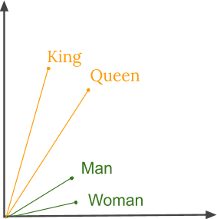
Graph Embeddings²²
Embedding in ML/AI consists of representing complex objects like text, images or graphs with continuous vectors of a reduced dimensionality compared to the dimensionality of the dataset, while keeping the most important information about them.

Slide 20
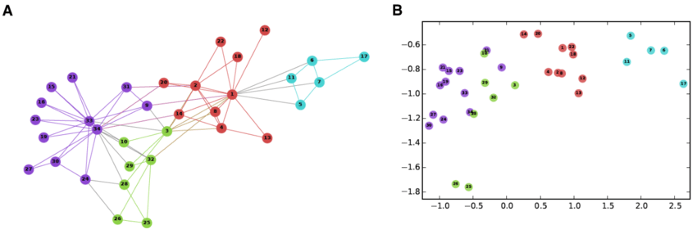
Graph Embeddings²²
Graph embeddings should capture the graph topology, node-to-node relationships, and content information.
Node embeddings
Whole graph embeddings
[23]

Slide 21
Node Embeddings²⁴
Each node is represented with a continuous vector of a fixed dimensionality. They are used to perform visualization or prediction at the node level, e.g., link prediction.
Popular techniques:
  Random Walk Based Approaches:
    DeepWalk⁴² : uses random walks to produce embeddings
    node2vec ⁴³ : modification of DeepWalk that provides control over the explored neighborhoods
  Deep Learning Approaches
    GraphSAGE ⁴⁵: an inductive scalable technique
    Graph Neural Networks**
Notes:
Factorization Approaches has been consistently outperformed by more recent methods

Slide 22
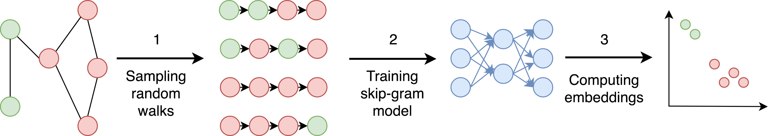
Node Embeddings²⁴
DeepWalk⁴²
The graph is sampled using random walks
A skip-gram (MLP) network accepts a node from the random walk as a one-hot vector as an input and maximizes the probability for predicting neighbor nodes
The node embedding is the output of the last hidden layer of the network
Notes:
2. Choose the middle node of a random walk as input and the words right and left of it as context

Slide 23
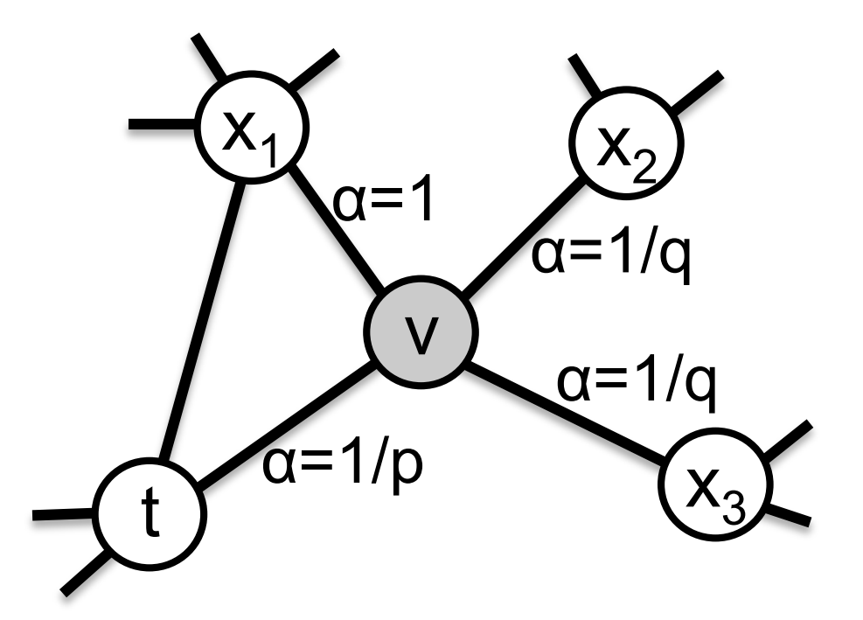
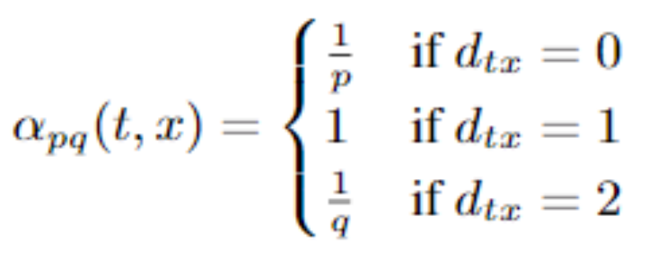
Node Embeddings²⁴
node2vec⁴³: modified random walks to better user exploration requirements
Each random walk accepts two (additional) parameters:
Q: controls the likehood to discover the undiscovered part of the graph
P: controls the likehood to return to the previous node
Notes:
Assume that we have just transitioned from t → v
X2, X3 are two hops from v
Small P keeps the walk local around v
Large P makes it less likely to visit an already visited node
Q < 1 DFS encourages outword exploration
Q > 1 BFS → local view

Slide 24
Node Embeddings^{24, 47, 48}
GraphSAGE⁴⁵: learns aggregator functions that can induce the embedding of a previously unseen node (thus inductive technique) given its features and neighborhood. It consists of two main components:
Context construction
Information Aggregation

Slide 25
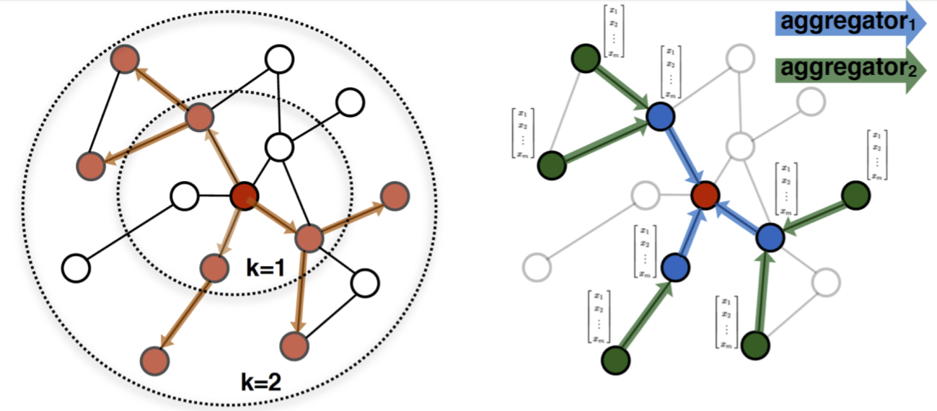
Node Embeddings^{24, 47, 48}
GraphSAGE⁴⁵
Context construction
  the neighborhood of a node consists of the nodes up to K hopes away form that node
  Assumption: nodes that reside in the same neighborhood should have similar embeddings

Slide 26
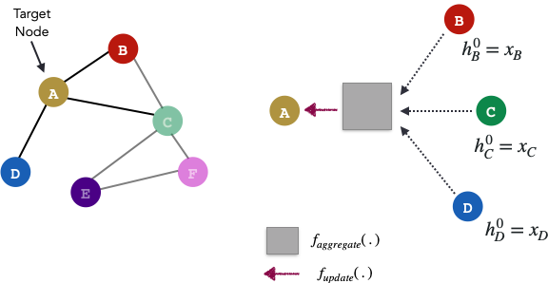
Node Embeddings^{24, 47, 48, 49}
GraphSAGE⁴⁵
Information Aggregation
  instead of learning node embeddings GraphSAGE learns aggregation functions
  aggregation functions accept a neighborhood as input and combine each neighbor’s embedding with weights to create a neighborhood embedding:
    LSTM on a random permutation of the nodes in a neighborhood
    average
    MLP followed by max pooling

Slide 27
Whole Graph Embeddings²⁴
The entire graph is represented with a single vector. They are used to make predictions at the graph level or to compare or visualize graphs, e.g., in the comparison of chemical structures.
graph2vec²⁵: unsupervised technique with relatively stable performance
Many other techniques but no clear winners:
  sub2vec (embed subgraphs)²⁷: produces subgraph embeddings
  UGRAPHEMB²⁸: an inductive method

Slide 28
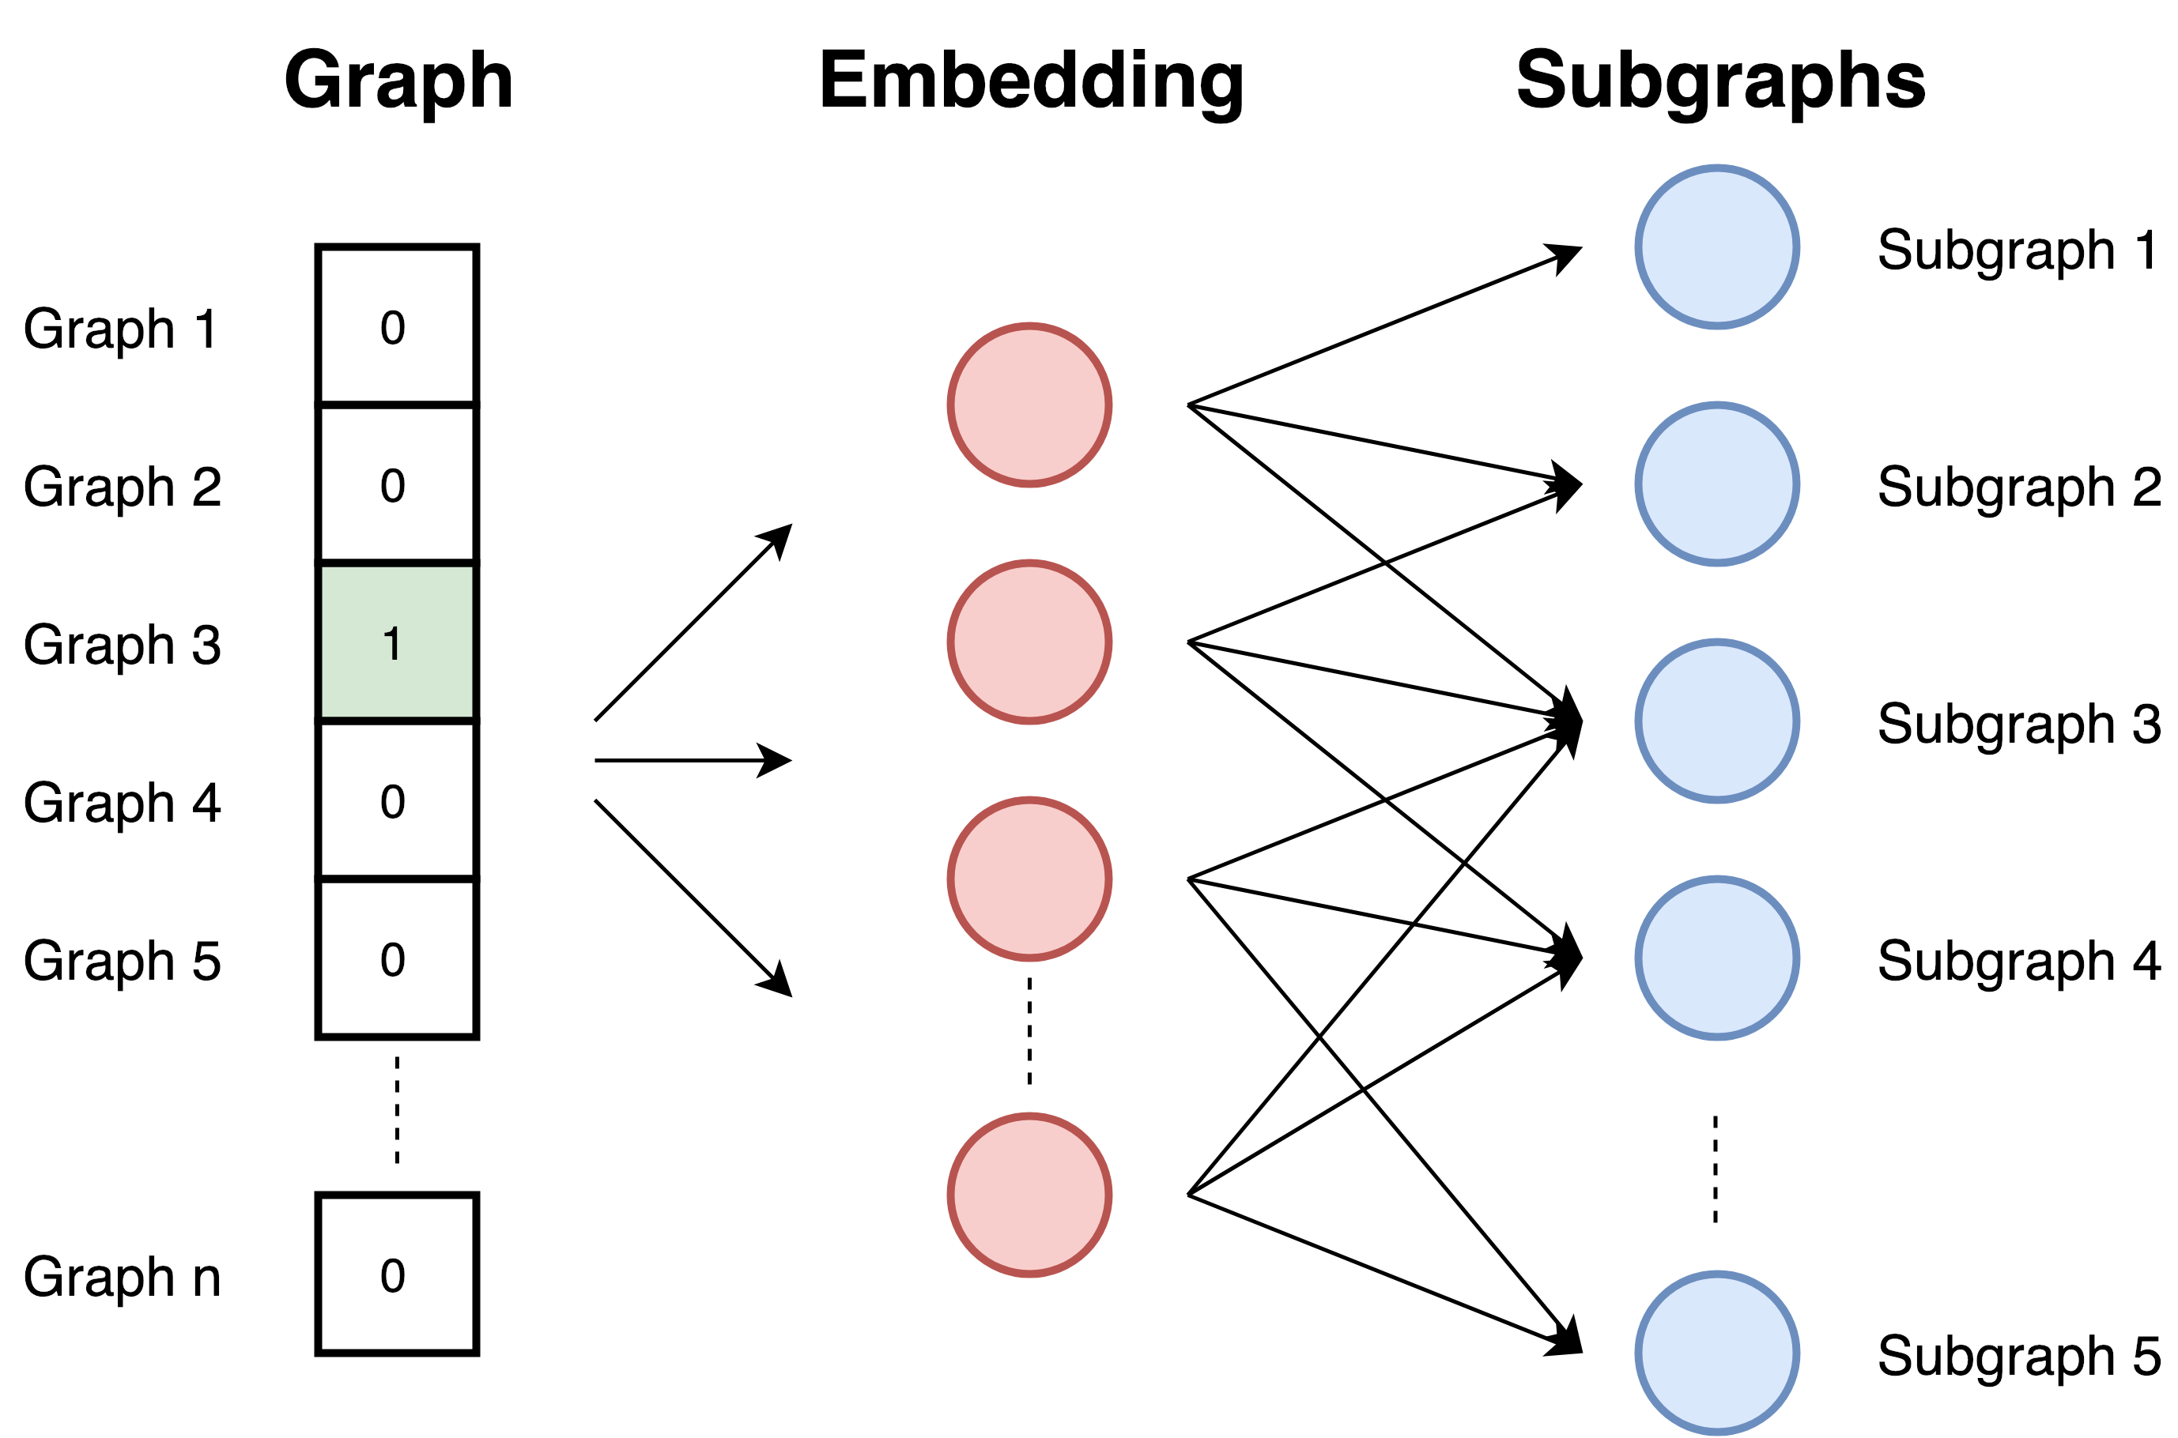
Whole Graph Embeddings²⁴
graph2vec²⁵: views the graph as a document and the rooted subgraphs around every node as words that compose the document. It is trained to maximize the probability of predicting subgraphs:

Slide 29
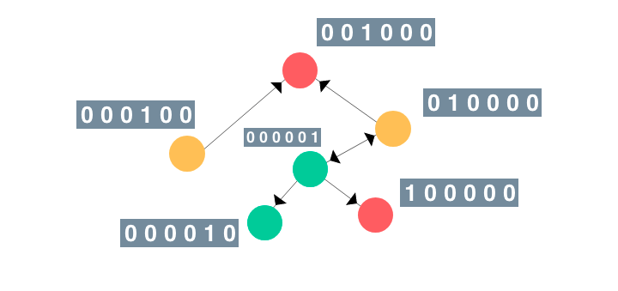
Graph Neural Networks^{50,51,53,55}
Graph Neural Networks (GNNs) are connectionist models that capture the relationships represented in the graphs:
there is one GNN ‘recurrent unit’ for each node in the graph: each unit maintains stateful information (embeddings) that captures
  the properties of the related node
  the neighborhood properties of that node
Notes:
Connectionist → modeling interactions, behaviors etc

Slide 30
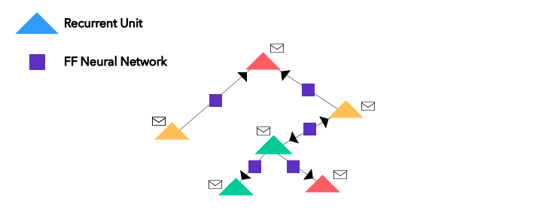
Graph Neural Networks^{50,51,53,55}
Graph Neural Networks (GNNs) are connectionist models that capture the relationships represented in the graphs:
an MLP for each edge learns the importance/properties of the underlying relation

Slide 31
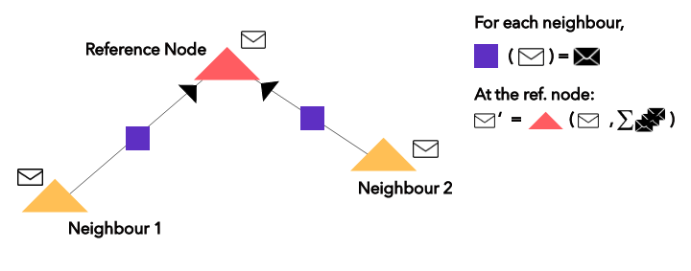
Graph Neural Networks^{50,51,53,55}
Graph Neural Networks (GNNs) are connectionist models that capture the relationships represented in the graphs:
neighborhood aggregation is employed to identify the dependencies between the nodes of graphs
Notes:
Messages are among immediate neighbors

Slide 32
Graph Neural Networks^{50,51,53,55}
Graph Neural Networks (GNNs) are connectionist models that capture the relationships represented in the graphs:
once neighborhood aggregation is performed the node embeddings capture more accurately the information about their own features and that of their neighboring nodes
the vector H that results by taking the sum of all the node embeddings represents the whole graph
Notes:
Messages are among immediate neighbors

Slide 33
Graph Neural Networks^{52,53,54}
Applications of GNNs:
  ML/AI
    Node classification
    Link Prediction
  Physical Systems: model Interaction Networks and predict future trajectories
  Chemistry:
    more flexible means to predict the properties of a new molecule by learning from example molecules
    predict side effects due to drug interactions
  Image Classification: alternative to CNNs to achieve zero-shot or few-shot learning
  Combinatorial Optimization: have shown promise as alternatives to relaxation-based techniques
  Social graphs: content recommendation
  Transportation: traffic prediction
  etc.

Slide 34
Hands-on graph-based ML/AI example
https://bitbucket.org/diip20201/tutorials/src/master/graph_based_data_science/

Slide 35
References
https://towardsdatascience.com/graph-databases-whats-the-big-deal-ec310b1bc0ed
https://snap.stanford.edu/data/
https://neo4j.com/blog/announcing-neo4j-for-graph-data-science/#:~:text=Graph%20data%20science%20uses%20multidisciplinary,artificial%20intelligence%20(AI)%20applications.
https://neo4j.com/blog/how-graphs-enhance-artificial-intelligence/
Alfred V. Aho, John E. Hopcroft and Jeffrey D. Ullman. Data Structures and Algorithms. Addison-Wesley, 1983
H. Lu, M. Halappanavar and A. Kalyanaraman: Parallel Heuristics for Scalable Community Detection, Parallel Computing, vol. 47, pp. 19-37, 2015
X. Zhu and Z. Ghahramani: Learning from Labeled and Unlabeled Data with Label Propagation, CMU CALD tech report CMU-CALD-02-107, 2002
J. Leskovec, K. J. Lang and M. W. Mahoney: Empirical Comparison of Algorithms for Network Community Detection, WWW 2010
G. S. Kido, R. A. Igawa and R. C. Garcia: Topic Modeling based on Louvain method in Online Social Networks, SBSI 2016
D. Meunier, R. Lambiotte, A. Fornito, K. D. Ersche, and Edward T. Bullmore: Hierarchical Modularity in Human Brain Functional Networks, Frontiers in Bioinformatics, 2009
https://neo4j.com/developer/graph-data-science/centrality-graph-algorithms/
https://www.brandwatch.com/blog/react-influential-men-and-women-2017/
S. Wu, L. Gong, W. Rand and L. Raschid, Making recommendations in a microblog to improve the impact of a focal user, SSRN Electronic Journal, 2002
V. E. Krebs: Mapping Networks of Terrorist Cells, Connections 2002
P. Bangcharoensap, H. Kobayashi, N. Shimizu, S. Yamauchi and T. Murata: Two Step graph-based semi-supervised Learning for Online Auction Fraud Detection, ECML PKDD 2015
C. Morselli and J. Roy: Brokerage qualifications in ringing operations, Criminology 2008
S. P. Borgatti: Centrality and Network Flow, Social Networks 2005
B. Jiang, S. Zhao and J. Yin: Self-organized Natural Roads for Predicting Traffic Flow: A Sensitivity Study, Journal of Statistical Mechanics Theory and Experiment 2007
T. T. Chitenderu: The Random Walk Theory And Stock Prices: Evidence From Johannesburg Stock Exchange, IBER 2014

Slide 36
References
T. Chondrogiannis, P. Bouros, J. Gamper and U. Leser: Alternative Routing: k-Shortest Paths with Limited Overlap, SIGSPATIAL 2015
L. Fitina, J. Impal, V. Uiari, N. Murki and E. Goodyear: An Application of Minimum Spanning Trees to Travel Planning, DWU Research Journal 2010
https://medium.com/@st3llasia/graph-embedding-techniques-7d5386c88c5
W. L. Hamilton, R. Ying and J. Leskovec: Representation Learning on Graphs: Methods and Applications, IEEE Data Engineering Bulletin 2007
https://towardsdatascience.com/graph-embeddings-the-summary-cc6075aba007
A. Narayanan, M. Chandramohan, R. Venkatesan, L. Chen, Y. Liu, and S. Jaiswal: graph2vec: Learning Distributed Representations of Graphs, MLG 2017
M. Niepert, M. Ahmed, K. Kutzkov: Learning Convolutional Neural Networks for Graphs ICML 2016
B. Adhikari, Y. Zhang, N. Ramakrishnan and B. A. Prakash: Sub2Vec: Feature Learning for Subgraphs, PAKDD 2018
Y. Bai, H. Ding, Y. Qiao, A. Marinovic, K. Gu, T. Chen, Y. Sun and W. Wang: Unsupervised Inductive Graph-Level Representation Learning via Graph-Graph Proximity, IJCAI 2019
W. Song, D. Wu, Y. Xi, Y. W. Park, and K. Cho, Motion-based skin region of interest detection with a real-time connected component labeling algorithm, Multimedia Tools and Applications, 2016.
M. Yip, N. Shadbolt, and C. Webber, Structural analysis of online criminal social networks, Intelligence and Security Informatics, 2012
M. Pershina, M. Yakout, K. Chakrabati: Holistic Entity Matching Across Knowledge Graphs, BigData 2015
https://sites.cs.ucsb.edu/~xyan/tutorial/KDD08_graph_partII.pdf
https://d-nb.info/985213434/34
https://arxiv.org/pdf/1903.11835.pdf
K. M. Borgward, C. S. Ong, S. Schönauer, S. V. N. Vishwanathan, A.J Smola and H.-P. Krigel: Protein function prediction via graph kernels, Bioinformatics 2005
M. P. Preeja and S. Kp: Walk-based Graph Kernel for Drug Discovery: A Review, International Journal of Computer Applications 2014
http://www.normastic.fr/wp-content/uploads/2019/05/presentation-03.05.2019.pdf

Slide 37
References
W. Yuan, K. He, D. Guan, L. Zhou and C. Li: Graph kernel based link prediction for signed social networks, Information Fusion 2019
N. Bui and V. Honavar: Labeling Actors in Social Networks Using a Heterogeneous Graph Kernel, SBP 2014
U. Losch, S. Bloehorn and A. Rettinger: Graph Kernels for RDF Data, ESWC 2012
Y. Tian, L. Zhao, X. Peng and D. N. Metaxas: Rethinking Kernel Methods for Node Representation Learning on Graphs, NeurIPS 2019
B. Perozzi, R. Al-Rfou and S. Skiena: Deep Walk: Online Learning of Social Representations, KDD 2014
A. Grover and J. Leskovec: node2vec: Scalable Feature Learning for Networks, KDD 2016
D. Wang, P. Cui, W. Zhu: Structural Deep Network Embedding, KDD 2016
W. L. Hamilton, R. Ying, and J. Leskovec: Inductive Representation Learning on Large Graphs, NIPS 2017
https://www.kaggle.com/ferdzso/knowledge-graph-analysis-with-node2vec
https://towardsdatascience.com/an-intuitive-explanation-of-graphsage-6df9437ee64f
http://snap.stanford.edu/graphsage/
https://medium.com/analytics-vidhya/ohmygraphs-graphsage-and-inductive-representation-learning-ea26d2835331
https://towardsdatascience.com/a-gentle-introduction-to-graph-neural-network-basics-deepwalk-and-graphsage-db5d540d50b3
F. Scarselli, M. Gori, A. Tsoi, M. Hagenbuchner and G. Monfardini: The graph neural network model, IEEE Transactions on Neural Networks, 20(1) 2009
https://towardsdatascience.com/https-medium-com-aishwaryajadhav-applications-of-graph-neural-networks-1420576be574
J. Zhou, G. Cui, Z. Zhang, C Yang, Z. Liu, L. Wang, C. Li, M. Sun: Graph Neural Networks: A Review of Methods and Applications, ArXiv 2018
https://blog.fastforwardlabs.com/2019/10/30/exciting-applications-of-graph-neural-networks.html
https://medium.com/dair-ai/an-illustrated-guide-to-graph-neural-networks-d5564a551783
N. Shervashidze, P. Schweitzer, E. J. van Leeuwen, K. Mehlhorn and K. M. Borgwardt: Weisfeiler-Lehman Graph Kernels, Journal of Machine Learning Research 12 (2011)
https://en.wikipedia.org/wiki/Kosaraju%27s_algorithm

