Slide 1
Probabilistic Graphical Models
Part 1: Overview and Applications

Slide 2
Outline
Motivation for Probabilistic Graphical Models
Applications of Probabilistic Graphical Models
Graphical Model Representation

Slide 3
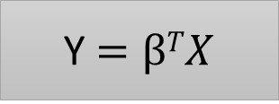
Probabilistic Modeling¹
when trying to solve a real-world problem using mathematics, it is common to define a mathematical model of the world, e.g.
often, the real world that we are trying to model involves a significant amount of uncertainty (e.g., the price of a house has a certain chance of going up if a new subway station opens within a certain distance).
to deal with uncertainty we usually model the world in the form of a probability distribution
X, Y are random variables
Y $=βTX$
P(X, Y)

Slide 4
Challenges of Probabilistic Modeling¹
  Assume a (probabilistic) model P_{θ}(Y, X₁, X₂, … X_{n}) of word occurrences in spam and non-spam mail:
  Each binary variable X_{i} encodes whether the i^{th} English word is present in the email
  The binary variable Y indicates whether the email is spam
  In order to classify a new email, we look at the probability P(Y = 1| X₁, X₂, … X_{n})

Slide 5
Challenges and Opportunities of Probabilistic Modeling¹
  Assume a (probabilistic) model P_{θ}(Y, X₁, X₂, … X_{n}) of word occurrences in spam and non-spam mail:
  The size (domain) of P_{θ} is huge (2^{N+1}, N being the size of the English vocabulary)
  Independence among variables can significantly decrease that domain:
    However: the conditional independence assumption among all the variables does not always result in a good prediction model (e.g., ‘pharmacy’ and ‘pills’ are probably highly dependent)
    Nonetheless: some variables are independent of each other (e.g., ‘muffin’ and ‘penguin’)

Slide 6
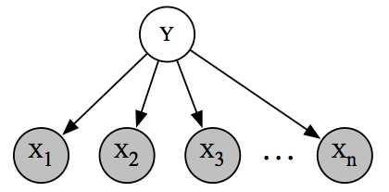
Challenges and Opportunities of Probabilistic Modeling¹
  Statistical independence conditions can be described and represented with a graph structure:
  P(X₁, X₂, …, X_{n} | y) = P(X₁|y) * P(X₂|y) * … *P(X_{n}|y)
Notes:
And that’s where Probabilistic Graphical Models come in place

Slide 7
Probabilistic Modeling¹
  Probabilistic Graphical Models (PGMs) form a powerful framework for representing/modeling complex real world domains using probability distributions. They:
  bring together graph theory and probability theory
  provide a flexible framework for modeling large collections of random variables with complex interactions
  enable the explicit representation of independences between variables with graphs
  leverage the graph representation to discover efficient (exact or approximate) inference and learning algorithms
  form the basis of causality theory

Slide 8
Applications¹
  Image processing
    unsupervised feature generation^{3,10}
    in-painting (reconstruction of small damaged portion of images)⁸
    image denoising⁹
  Audio
    speech synthesis⁷
    speech recognition⁶
  Information/Coding Theory: error-correcting codes
  Computer Science: spam filtering/document classification (Bayesian models have been used in the Gmail spam filtering algorithm)
  Computer Networks
    cooperative localization
    time scheduling
Notes:
In general, MRFs where the go to model for image processing before DL and many powerful models are a combination of PGM+DL

Slide 9
Applications¹
  Science
    Computational Biology⁵: computational network biology
    Genetics: Bayesian Networks are used in Gene Regulatory Networks to model cell behavior and to form relevant predictions
    Ecology: used to study phenomena that evolve over space and time, capturing spatial and temporal dependencies (e.g., bird migrations)
    Economics : can model spatial distributions of quantities of interests (e.g., assets or expenditures-based measures of wealth)
  Healthcare and Medicine
    Disease Diagnosis⁴: used to model the possible symptoms and predict whether a person is infected/diseased etc.
    Biomonitoring: Bayesian Networks play an important role in monitoring the quantity of chemical dozes used in pharmaceutical drugs
  Transportation: traffic analysis

Slide 10
Graphical Model Representation

Slide 11
Graphical Model Representation¹
  In PGMs the relationships between random variables are described by graphs whose properties (e.g., connectivity, tree-width) reveal probabilistic and algorithmic features of the model (e.g., independence, learning complexity).
Directed Graphical Models (DGMs) : employ directed graphs
  directed edges describe causality relationship between random variables
Undirected Graphical Models (UGMs) : employ undirected graphs
  Moralized Graphs: undirected versions of DGMs
  Conditional Random Fields: discriminative incarnation of UGMs
  Factor Graphs: both variables and functions are represented in the graph
Latent Variable Models: DGMs or UGMs where some variables are never observed
Models with Continuous Variables

Slide 12
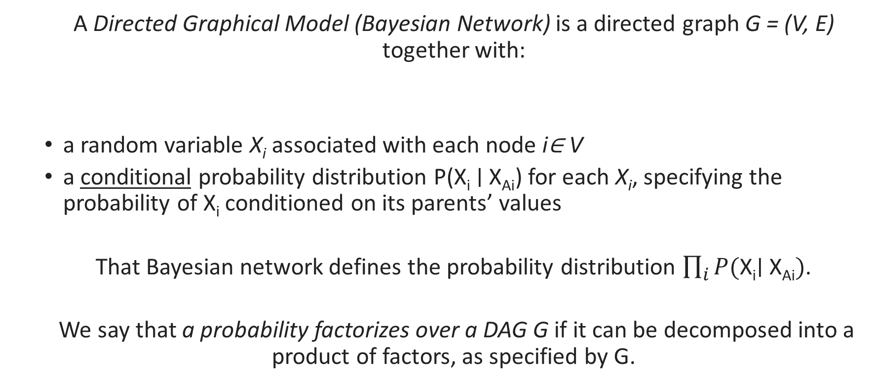
Directed Graphical Models¹
  A Directed Graphical Model (Bayesian Network) is a directed graph G = (V, E) together with:
  a random variable X_{i} associated with each node i∈ V
  a conditional probability distribution P(X_{i} ∣ X_{Ai}) for each X_{i}, specifying the probability of X_{i} conditioned on its parents’ values
  That Bayesian network defines the probability distribution $\prod_{i}{P(\text{X}\text{i}\text{∣ }\text{X}\text{Ai})}$.
  We say that a probability factorizes over a DAG G if it can be decomposed into a product of factors, as specified by G.

Slide 13
Directed Graphical Models²
  Bayesian network model for lung cancer diagnosis:
is_smoking
p(is_smoking = T) = 0.2
p(is_smoking = F) = 0.8
has_lung_cancer
has_bronchitis
p(has_lung_cancer = T | is_smoking = T) = 0.3
p(has_lung_cancer = F | is_smoking = T) = 0.7
p(has_lung_cancer = T | is_smoking = F) = 0.005
p(has_lung_cancer = F | is_smoking = F) = 0.995
p(has_bronchitis = T | is_smoking = T) = 0.25
p(has_bronchitis = F | is_smoking = T) = 0.75
p(has_bronchitis = T | is_smoking = F) = 0.05
p(has_bronchitis = F | is_smoking = F) = 0.95
has_abnormal_X-rays
p(has_abnormal_X-rays = T | has_lung_cancer = T) = 0.6
p(has_abnormal_X-rays = F | has_lung_cancer = T) = 0.4
p(has_abnormal_X-rays = T | has_lung_cancer = F) = 0.02
p(has_abnormal_X-rays = F | has_lung_cancer = F) = 0.98

Slide 14
Directed Graphical Models²
  Bayesian network model for lung cancer diagnosis. It defines the joint probability distribution:
  P(has_abnormal_X-rays, has_lung_cancer, has_bronchitis, is_smoking) =
      P(is_smoking) *
      P(has_lung_cancer | is_smoking) *
      P(has_bronchitis | is_smoking) *
      P(has_abnormal_X-rays | has_lung_cancer)

Slide 15
Directed Graphical Models²
  Bayesian network model for lung cancer diagnosis. It defines the probability distribution:
  P(has_abnormal_X-rays, has_lung_cancer, has_bronchitis, is_smoking) =
      P(is_smoking) *
      P(has_lung_cancer | is_smoking) *
      P(has_bronchitis | is_smoking) *
      P(has_abnormal_X-rays | has_lung_cancer)
      This distribution can be represented with 7 parameters as opposed to 2⁴- 1 = 15 parameters that the distribution with no independence assumptions needs

Slide 16
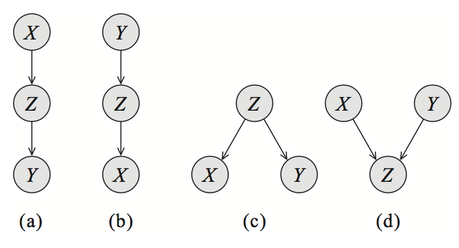
Relationships described by Directed Graphical Models²
  Independencies can be recovered from a DGM graph by looking at three types of structures:
  Cascade (a), (b):
  if Z is observed X ⫫ Y | Z
  Common Parent (c) :
  if Z is observed X ⫫ Y | Z
  V-structure (d)
  if Z is unobserved X ⫫ Y | Z
  The above rules are applied recursively on larger graphs

Slide 17
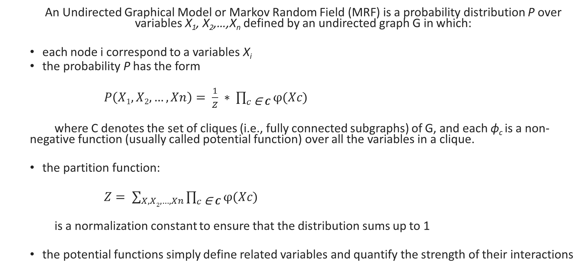
Undirected Graphical Models¹
  An Undirected Graphical Model or Markov Random Field (MRF) is a probability distribution P over variables X₁, X₂,…,X_{n} defined by an undirected graph G in which:
  each node i correspond to a variables X_{i}
  the probability P has the form
  $P\left(X1, X2, …,Xn\right)= \frac{1}{Z} ∗ \prod_{c \text{∈} C}{φ(Xc)}$
  where C denotes the set of cliques (i.e., fully connected subgraphs) of G, and each ϕ_{c} is a non-negative function (usually called potential function) over all the variables in a clique.
  the partition function:
  $Z= \sum_{X, X2, …, Xn}{\prod_{c \text{∈ }C}{φ(Xc)}}$
  is a normalization constant to ensure that the distribution sums up to 1
  the potential functions simply define related variables and quantify the strength of their interactions

Slide 18
Undirected Graphical Models²
  An MRF to model voting preferences among four people: Alice (A), Bob (B), Charlie (C), David (D). Assume an election against two (2) candidates. Also assume (A, B), (B, C), (C, D) and (D, A) are friends. Friends tend to have similar voting preferences:
Alice_{vote}
Bob_{vote}
David_{vote}
Charlie_{vote}

Slide 19
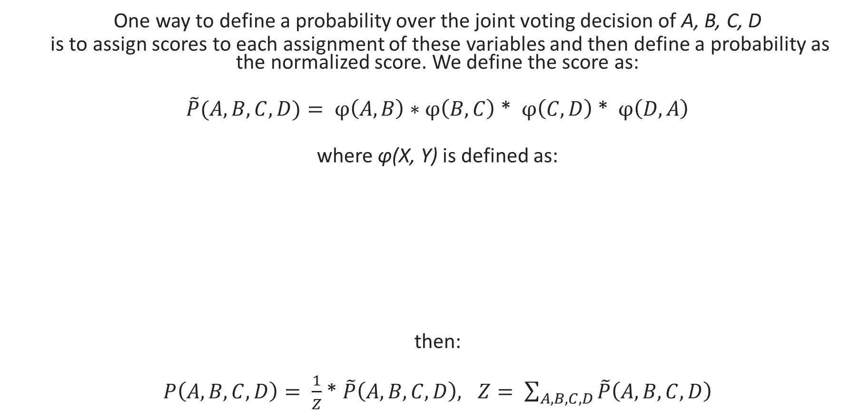
Undirected Graphical Models²
  One way to define a probability over the joint voting decision of A, B, C, D
  is to assign scores to each assignment of these variables and then define a probability as the normalized score. We define the score as:
  $\tilde{P}(A, B, C, D)= φ\left(A, B\right)∗φ\left(B, C\right)$ * $φ\left(C, D\right)$ * $φ\left(D, A\right)$
  where φ(X, Y) is defined as:
  then:
  $P\left(A, B, C, D\right)= \frac{1}{Z}$ * $\tilde{P}\left(A, B, C, D\right), Z= \sum_{A, B, C, D}{\tilde{P}\left(A, B, C, D\right)}$
X | Y | φ
1 | 1 | 10
0 | 0 | 5
1 | 0 | 1
0 | 1 | 1

Slide 20
Undirected Graphical Models²
  One way to define a probability over the joint voting decision of A, B, C, D
  is to assign scores to each assignment of these variables and then define a probability as the normalized score. We define the score as:
  $\tilde{P}(A, B, C, D)= φ\left(A, B\right)∗φ\left(B, C\right)$ * $φ\left(C, D\right)$ * $φ\left(D, A\right)$
  where φ(X, Y) is defined as:
  then:
  $P\left(A, B, C, D\right)= \frac{1}{Z}$ * $\tilde{P}\left(A, B, C, D\right), Z= \sum_{A, B, C, D}{\tilde{P}\left(A, B, C, D\right)}$
X | Y | φ
1 | 1 | 10
0 | 0 | 5
1 | 0 | 1
0 | 1 | 1
Dependencies Encoded
A ⫫ C | {B, D}
B ⫫ D | {A, C}

Slide 21
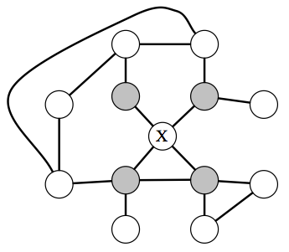
Relationships described by Undirected Graphical Models²
  Independencies can be recovered from a UGM graph by looking at the direct neighbors of each node:
  If X’s neighbors are all observed, then
  X is independent of all the other variables,
  since the latters’ influence X only via its
  neighbors

Slide 22
Comparison of Bayesian Networks and MRFs¹
  MRFs are ‘more’ powerful but both can succinctly represent difference types of dependencies
  MRFs can be applied to a wider range of problems in which there is no natural directionality associated with variable dependencies
  computing the normalization constant in MRFs requires summing over a potentially exponential number of assignments
  MRFs may be difficult to interpret.
  it is much easier to generate data from a Bayesian network, which is important in some applications

Slide 23
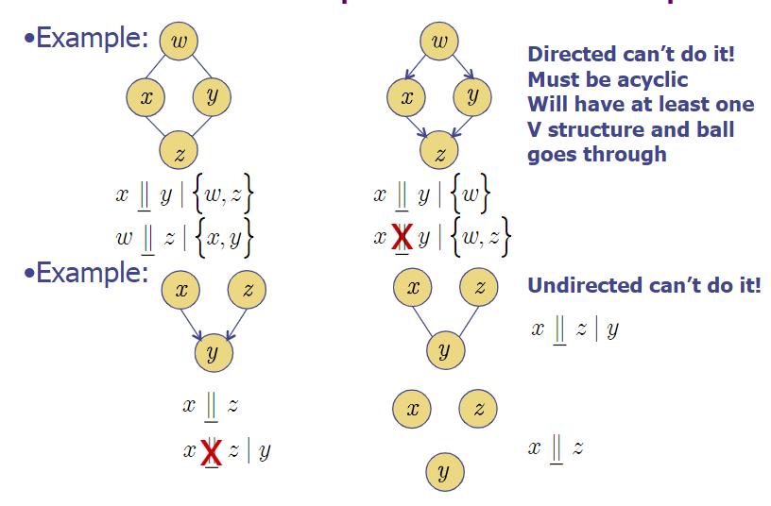
Comparison of Bayesian Networks and MRFs¹¹
Directed can’t do it
Undirected can’t do it

Slide 24
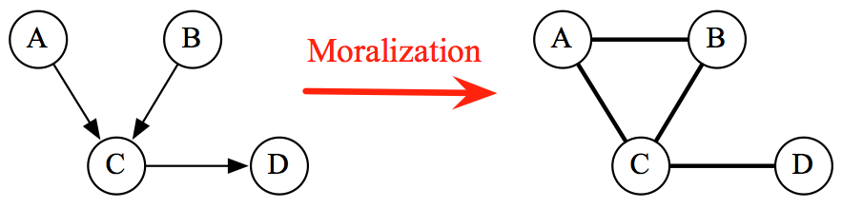
Moralized Graphs¹
  Convert a Bayesian network into an undirected form.
  If we take a directed graph and add side edges to all parents of a given node and remove directionalities, then the original CPDs factorize over the resulting graph.
  Moralized graphs are used in many inference algorithms

Slide 25
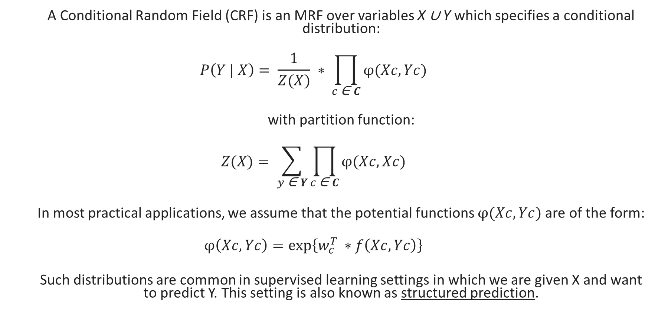
Conditional Random Fields¹
  A Conditional Random Field (CRF) is an MRF over variables X ∪ Y which specifies a conditional distribution:
  $$P\left(Y | X\right)= \frac{1}{Z(X)} ∗ \prod_{c \text{∈} C}{φ(Xc, Yc)}$$
  with partition function:
  $$Z(X)= \sum_{y \text{∈ }Y}{\prod_{c \text{∈ }C}{φ(Xc, Xc)}}$$
  In most practical applications, we assume that the potential functions $φ(Xc, Yc)$are of the form:
  $$φ\left(Xc, Yc\right)=\exp\left\{w_{c}^{T }∗f\left(Xc, Yc\right)\right\}$$
  Such distributions are common in supervised learning settings in which we are given X and want to predict Y. This setting is also known as structured prediction.

Slide 26
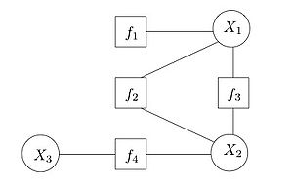
Factor Graphs¹
  A factor graph is a bipartite graph where one group is the variables in the distribution, and the other group is the potential functions (factors) defined on these variables. Edges are between factors and variables that those factors depend on.
  The (unnormalized) probability distribution is equal to the multiple of all the factors in the factor graph:
  P(X₁, X₂, X₃) ~ f₁(X₁) * f₂(X₁, X₂) * f₃(X₁, X₂) * f₄(X₃)

Slide 27
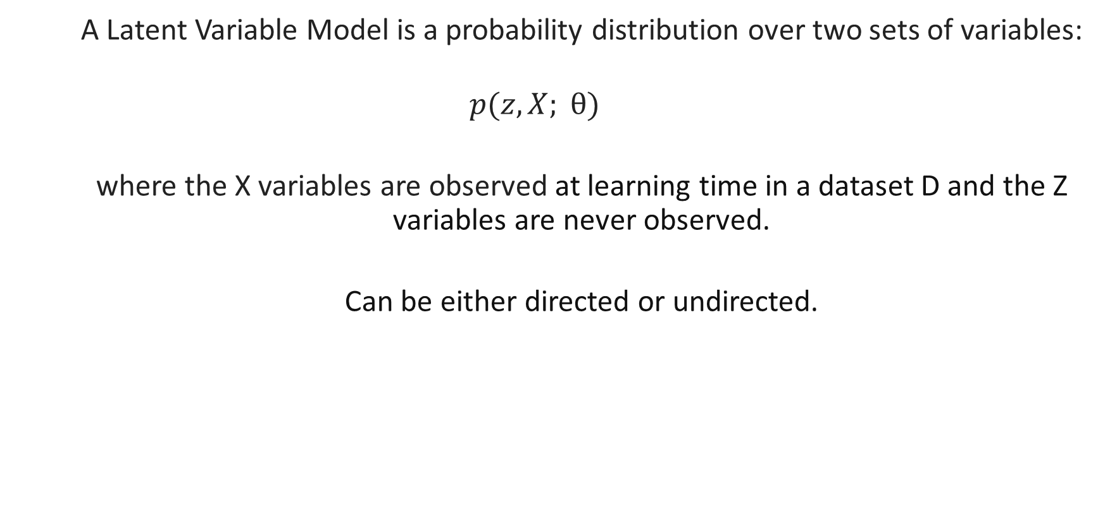
Latent Variable Models¹
  A Latent Variable Model is a probability distribution over two sets of variables:
  $$p(z, X; θ)$$
  where the X variables are observed at learning time in a dataset D and the Z variables are never observed.
  Can be either directed or undirected.

Slide 28
Latent Variable Models¹
  Example: Flipping a Biased Coin N times
is_biased
outcome₁
outcome₂
outcome₃
outcome₄
…..
outcome_{N}

Slide 29
Graphical models with continuous variables
  Some of the nodes represent continuous random variables
  Many powerful models
    Kalman Filter
    Gaussian Markov Random Fields
  Training / inference becomes challenging
    Only specific PDFs (multidimensional normal) have been employed in practice
Notes:
A common application is for guidance, navigation, and control of vehicles
Spatial statistics

Slide 30
References
https://cs.stanford.edu/~ermon/cs228/index.html
http://ftp.mi.fu-berlin.de/pub/bkeller/MatLab/Examples/bayes/lungbayesdemo.html
A. Radford, L. Metz and S. Chintala: Unsupervised Representation Learning with Deep Convolutional Generative Adversarial Networks, ICLR 2016
D. Aronsky and P. J. Haug: Diagnosing community-acquired pneumonia with a Bayesian network, Proc. AMIA Symposium 1998
Y. Ni, P. Müller, L. Wei and Y. Ji: Bayesian graphical models for computational network biology, BMC Bioinformatics 63(2018)
J. A. Bilmes: Graphical Models and Automatic Speech Recognition, The Journal of the Acoustical Society of America, 2011
W.-N. Hsu, Y. Zhang, R. J. Weiss, H. Zen, Y. Wu, Y. Wang, Y. Cao, Y. Jia, Z. Chen, J. Shen, P. Nguyen and R Pang: Hierarchical Generative Modeling for Controllable Speech Synthesis, ICLR 2019
W. Ping and A.T. Ihler: Belief Propagation in conditional RBMS for structured prediction, AISTATS 2017
https://www.mpi-inf.mpg.de/fileadmin/inf/d2/GM/2016/gm-2016-1213-imageprocessing.pdf
D. P. Kingma and M. Welling : An Introduction to Variational Autoencoders, Foundations and Trends in Machine Learning: Vol. 12 (2019)
http://www.cs.columbia.edu/~jebara/4771/notes/class16x.pdf

