Slide 1
Probabilistic Graphical Models
Part 2: Inference and Learning

Slide 2
Outline
Inference
  Marginal Inference
  Posterior Inference
  Maximum a posteriori inference
Learning: Training Probabilistic Graphical Models
  Parameter Learning
  Structure Learning
Hands-on DGM and UDM examples

Slide 3
Inference

Slide 4
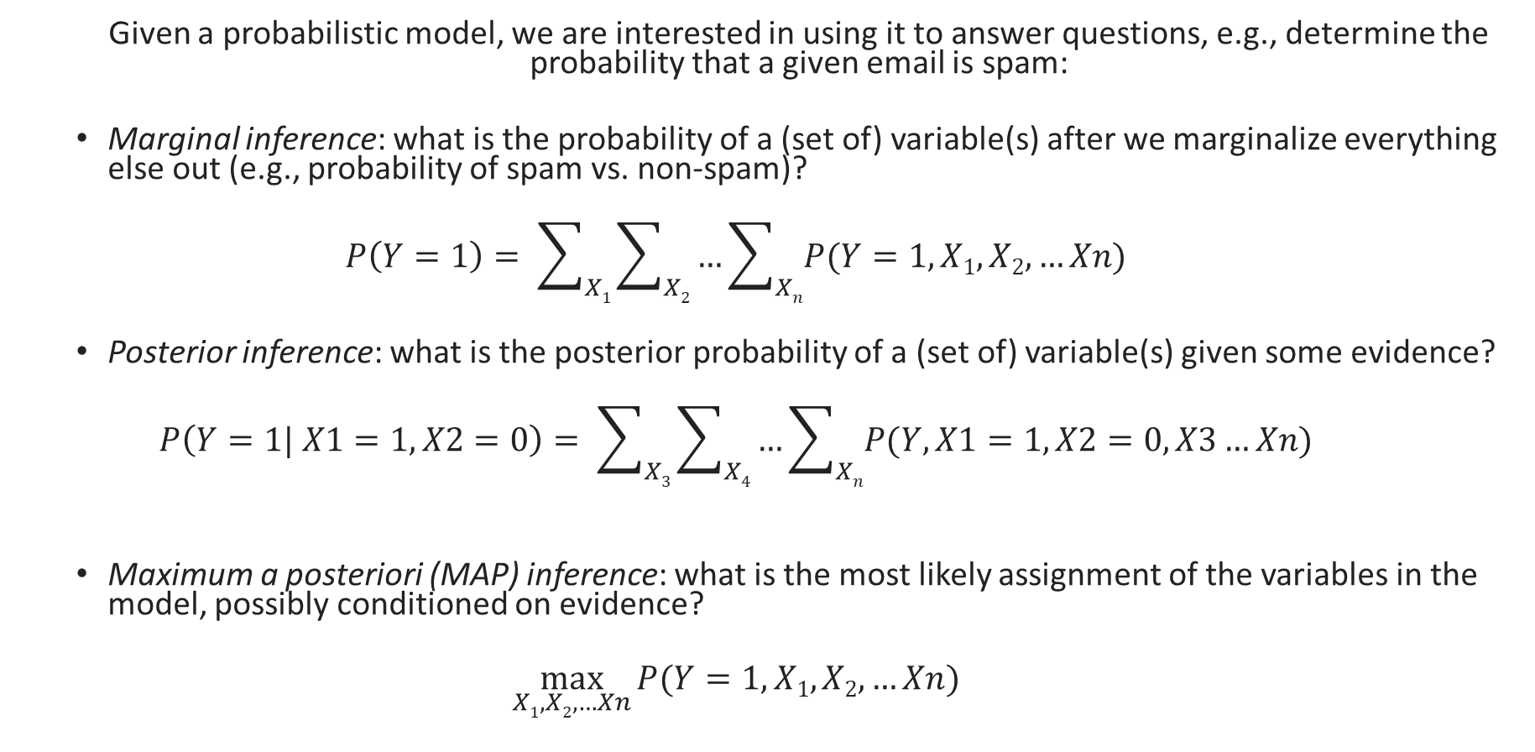
Inference¹
  Given a probabilistic model, we are interested in using it to answer questions, e.g., determine the probability that a given email is spam:
  Marginal inference: what is the probability of a (set of) variable(s) after we marginalize everything else out (e.g., probability of spam vs. non-spam)?
  $$P\left(Y=1\right)= \sum_{X1}{\sum_{X2}{…\sum_{Xn}{P(Y=1, X1, X2, …Xn)}}}$$
  Posterior inference: what is the posterior probability of a (set of) variable(s) given some evidence?
  $$P\left(Y=1| X1=1, X2=0\right)= \sum_{X3}{\sum_{X4}{…\sum_{Xn}{P(Y,X1=1, X2=0,X3…Xn)}}}$$
  Maximum a posteriori (MAP) inference: what is the most likely assignment of the variables in the model, possibly conditioned on evidence?
  $$\max_{X1,X2,…Xn}{P(Y=1, X1, X2, …Xn)}$$
Notes:
Posterior inference is a special case of marginal inference with provided evidence

Slide 5
Summary of Inference Methods¹
Method | Type of Inference | Exact/Approximate | Properties
Variable Elimination | Marginal/Posterior | Exact | Finds marginal of one variable
Belief Propagation | Marginal/Posterior | Exact | Finds marginal of all variables Works on tree structures
Junction Tree | Marginal/Posterior | Exact | Works on general graphs May become intractable
Loopy Belief Propagation | Marginal/Posterior | Approximate | Works on general graphs
MIP based | MAP | Exact | Works on general graphs Usually creates large MIP problems
Max-product | MAP | Exact | Works on tree structures
Sampling based | Marginal/Posterior/MAP | Approximate | Draws samples from the joint distribution
Variational Inference | Marginal/Posterior/MAP | Approximate | Replaces joint distribution with a simpler one

Slide 6
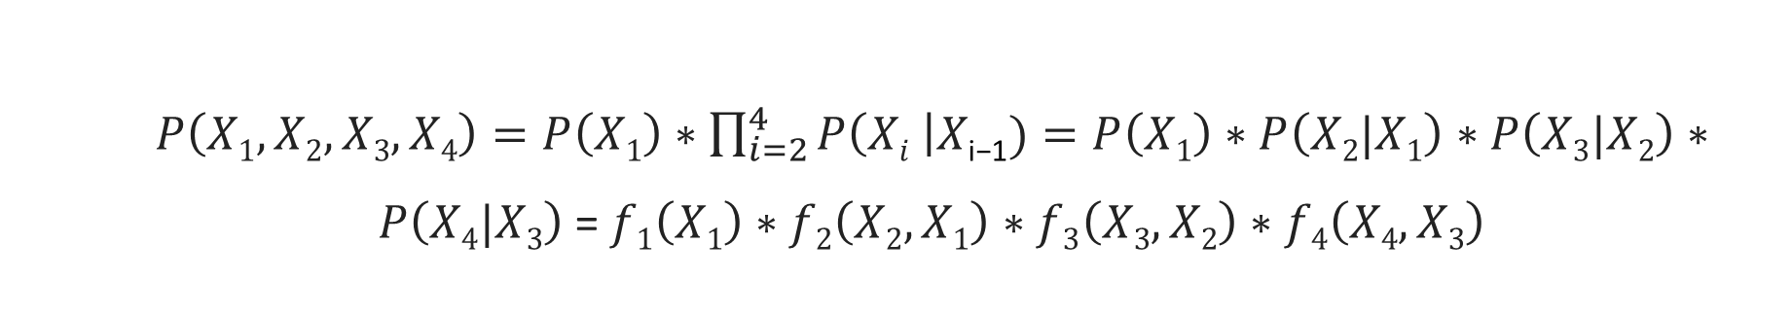
Marginal Inference – Variable Ellimination¹
X₁
X₂
X₃
X₄
  Illustrative Example:
  Assume a chain Bayesian Network with probability distribution of the form:
  We are interested in computing the marginal probability P(X₄).
  $P\left(X1, X2,X3,X4\right)=P\left(X1\right)∗\prod_{i=2}^{4}{P\left(Xi \right|X\text{i}\text{−1})}=P\left(X1\right)∗P\left(X2|X1\right)∗P\left(X3|X2\right)∗P\left(X4|X3\right)$ = $f1\left(X1\right)∗f2\left(X2,X1\right)∗f3\left(X3,X2\right)∗f4\left(X4,X3\right)$

Slide 7
Marginal Inference – Variable Ellimination¹
X₁
X₂
X₃
X₄
  Illustrative Example:
  Assume a chain Bayesian Network with probability distribution of the form:
  We are interested in computing the marginal probability P(X₄).
  Naïve Way:
  $P\left(X1, X2,X3,X4\right)=P\left(X1\right)∗\prod_{i=2}^{4}{P\left(Xi \right|X\text{i}\text{−1})}=P\left(X1\right)∗P\left(X2|X1\right)∗P\left(X3|X2\right)∗P\left(X4|X3\right)$ = $f1\left(X1\right)∗f2\left(X2,X1\right)∗f3\left(X3,X2\right)∗f4\left(X4,X3\right)$
  $$P\left(X4\right)=\sum_{X3}{\sum_{X2}{\sum_{X1}{f1\left(X1\right)∗f2\left(X2,X1\right)∗f3\left(X3,X2\right)∗f4\left(X4,X3\right)}}}$$

Slide 8
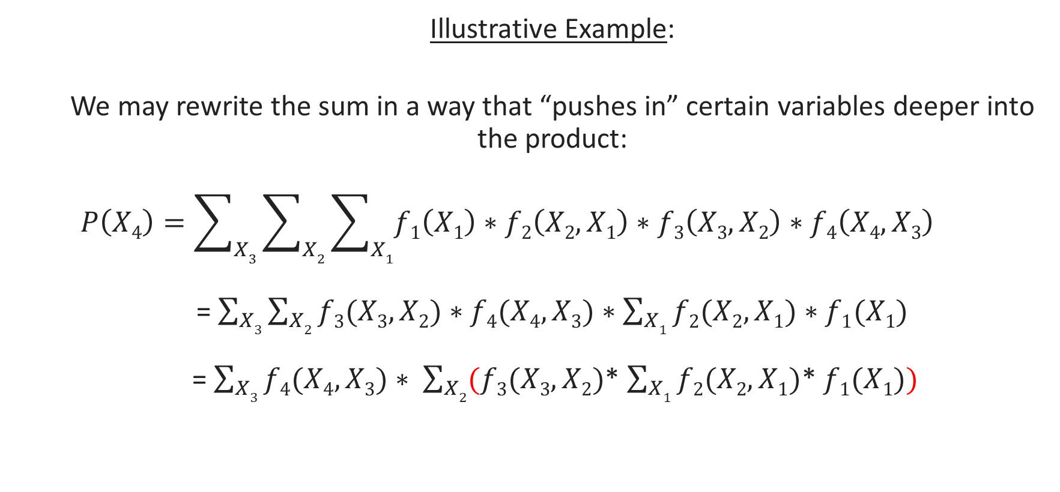
Marginal Inference – Variable Ellimination¹
X₁
X₂
X₃
X₄
  Illustrative Example:
  We may rewrite the sum in a way that “pushes in” certain variables deeper into the product:
  $$P\left(X4\right)=\sum_{X3}{\sum_{X2}{\sum_{X1}{f1\left(X1\right)∗f2\left(X2,X1\right)∗f3\left(X3,X2\right)∗f4\left(X4,X3\right)}}}$$
  = $\sum_{X3}{\sum_{X2}{f3(X3, X2)∗f4(X4, X3)}∗\sum_{X1}{f2(X2, X1)∗f1(X1)}}$
  = $\sum_{X3}{f4(X4, X3)}∗ \sum_{X2}{(f3(X3, X2)}$* $\sum_{X1}{f2(X2, X1)}$* $f1(X1))$

Slide 9
Marginal Inference – Variable Ellimination¹
  can answer marginal inference queries for both directed and undirected networks
  algorithm must be restarted from scratch for each variable

Slide 10
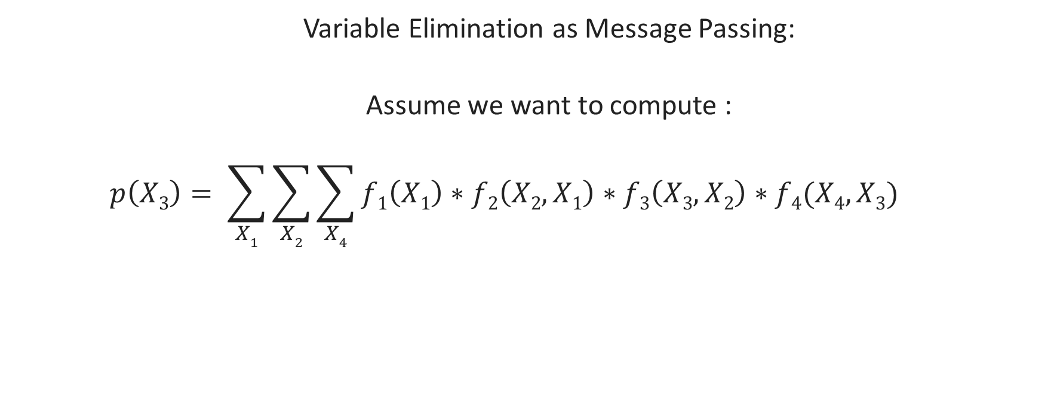
Marginal Inference – Belief Propagation¹
  Variable Elimination as Message Passing:
  Assume we want to compute :
  $$p\left(X3\right)= \sum_{X1}{\sum_{X2}{\sum_{X4}{f1\left(X1\right)∗f2\left(X2,X1\right)∗f3\left(X3,X2\right)∗f4(X4,X3)}}}$$
X₁
X₂
X₃
X₄
moralized graph
X₁
X₂
X₃
X₄

Slide 11
Marginal Inference – Belief Propagation¹
  Variable Elimination as Message Passing:
  Root the tree at X₃:
X₁
X₃
X₂
X₂
X₄
X₃
X₁
X₄

Slide 12
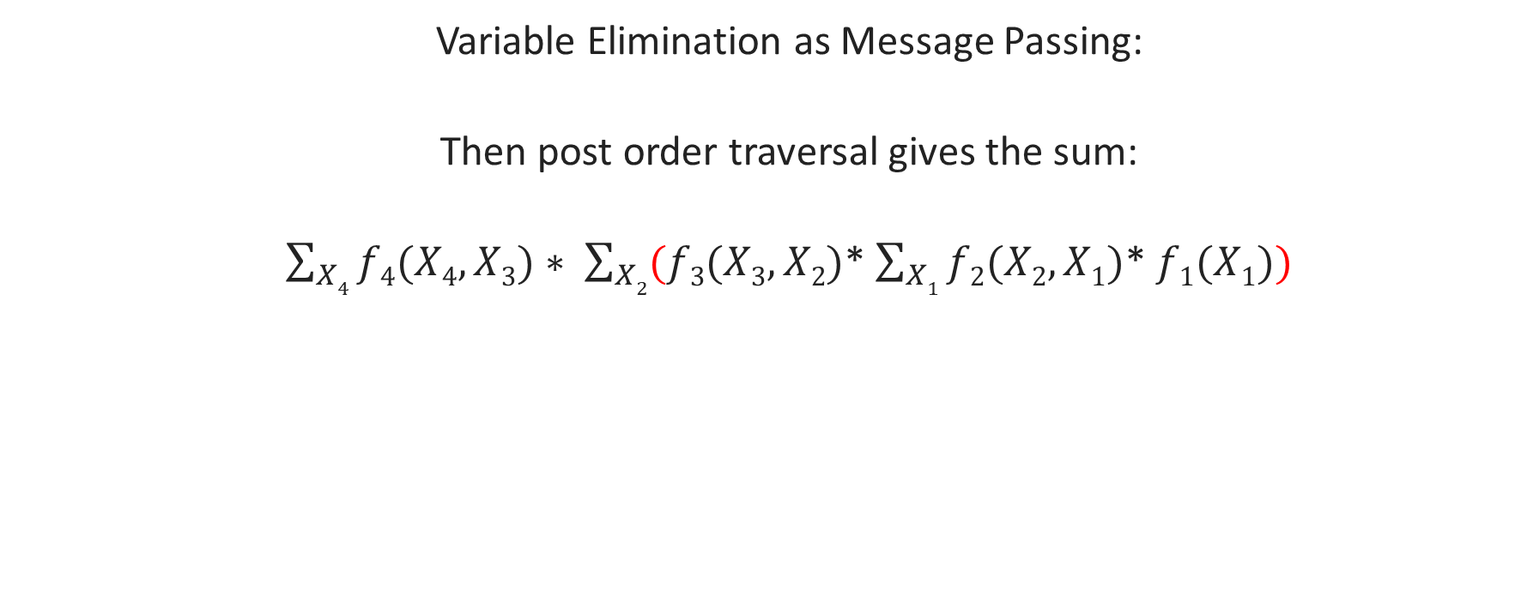
Marginal Inference – Belief Propagation¹
  Variable Elimination as Message Passing:
  Then post order traversal gives the sum:
  $\sum_{X4}{f4(X4, X3)}∗ \sum_{X2}{(f3(X3, X2)}$* $\sum_{X1}{f2(X2, X1)}$* $f1(X1))$
X₃
X₂
X₄
X₁

Slide 13
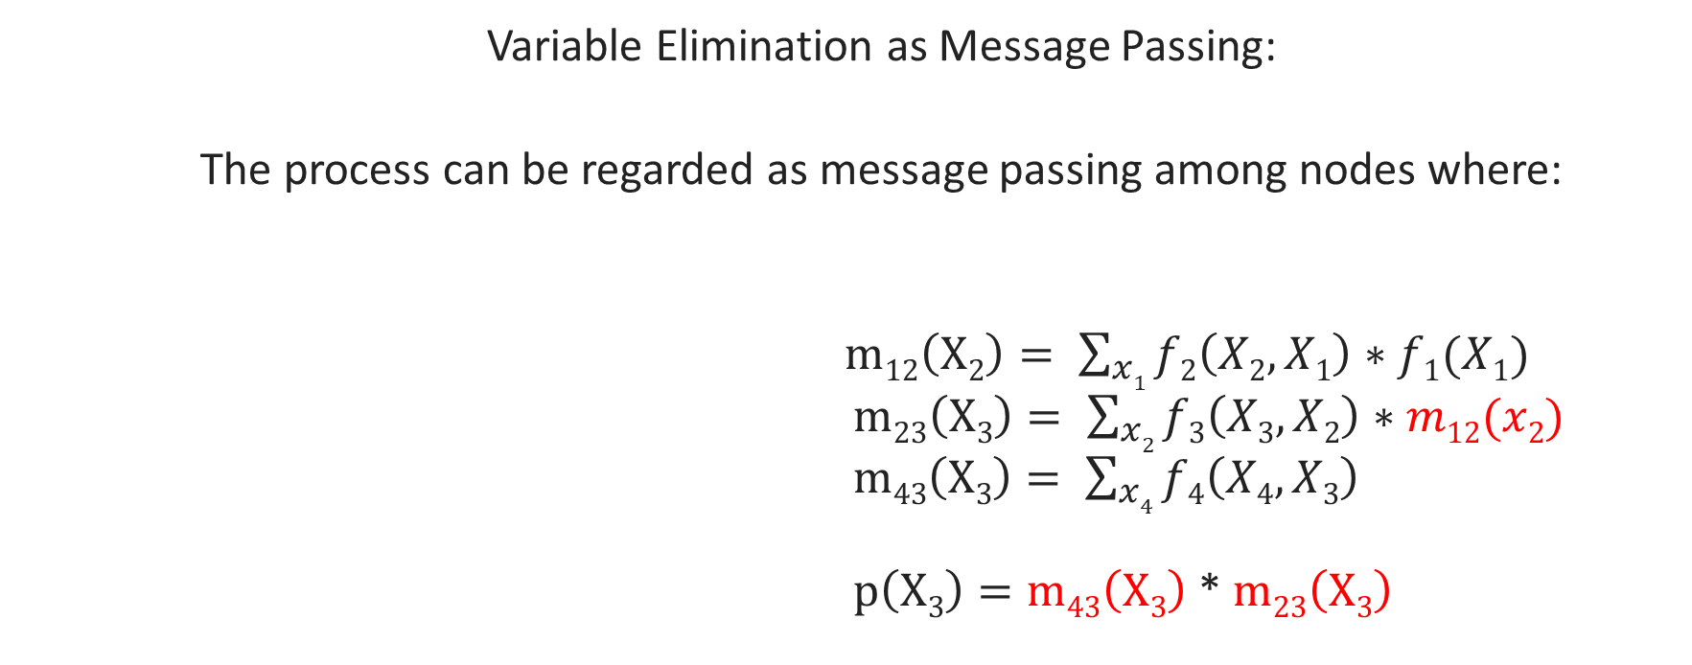
Marginal Inference – Belief Propagation¹
  Variable Elimination as Message Passing:
  The process can be regarded as message passing among nodes where:
  $m12\left(X2\right)= \sum_{x1}{f2\left(X2, X1\right)∗f1(X1)}$
  $m23\left(X3\right)= \sum_{x2}{f3\left(X3, X2\right)∗m12(x2)}$
  $m43\left(X3\right)= \sum_{x4}{f4\left(X4, X3\right)}$
  $p\left(X3\right)=m43\left(X3\right)$ * $m23\left(X3\right)$
X₃
m₂₃(x₃)
m₄₃(x₃)
X₂
X₄
m₁₂(x₂)
X₁

Slide 14
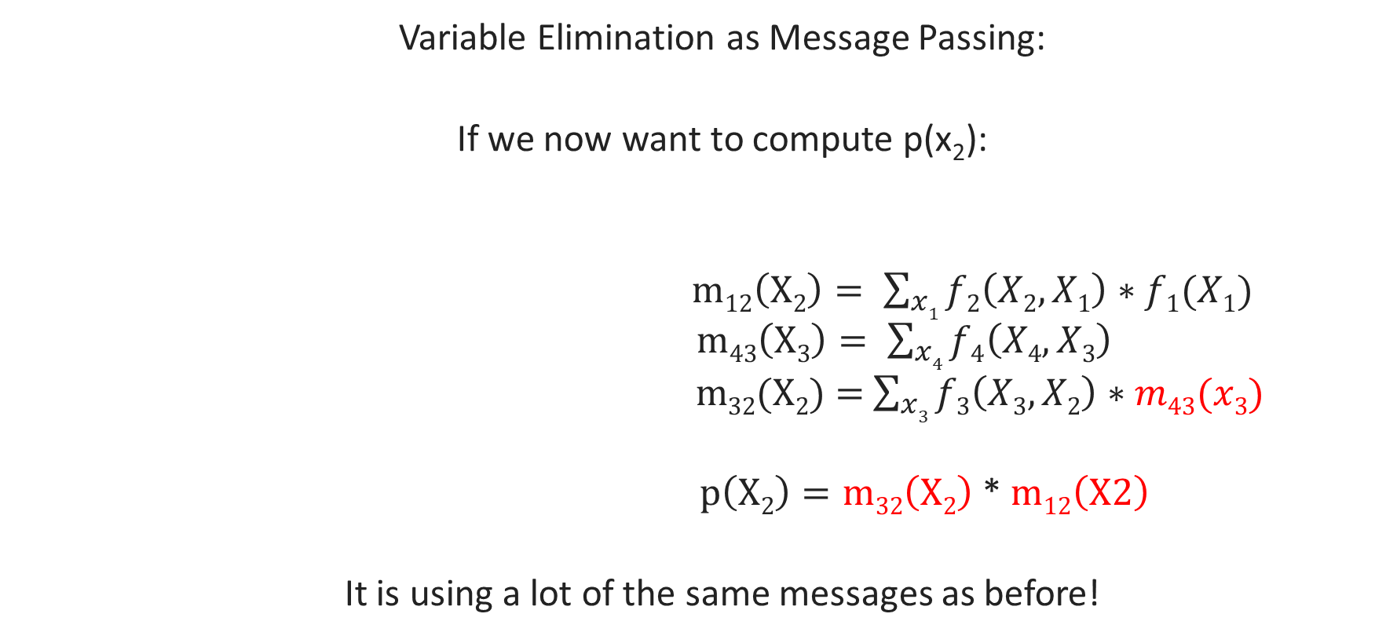
Marginal Inference – Belief Propagation¹
  Variable Elimination as Message Passing:
  If we now want to compute p(x₂):
  $m12\left(X2\right)= \sum_{x1}{f2\left(X2, X1\right)∗f1(X1)}$
  $m43\left(X3\right)= \sum_{x4}{f4\left(X4, X3\right)}$
  $m$₃₂(X₂) = $\sum_{x3}{f3\left(X3, X2\right)∗m43(x3)}$
  $p\left(X2\right)=m32\left(X2\right)$ * $m12\left(X2\right)$
  It is using a lot of the same messages as before!
X₂
m₃₂(x₂)
m₁₂(x₂)
X₃
X₁
m₄₃(x₃)
X₄

Slide 15
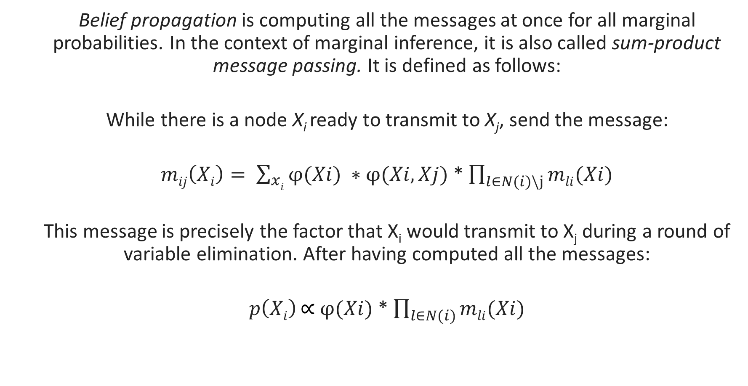
Marginal Inference – Belief Propagation¹
  Belief propagation is computing all the messages at once for all marginal probabilities. In the context of marginal inference, it is also called sum-product message passing. It is defined as follows:
  While there is a node X_{i} ready to transmit to X_{j}, send the message:
  $mij\left(Xi\right)= \sum_{xi}{φ(Xi)} ∗φ(Xi,Xj)$ * $\prod_{l∈N(i)\backslash j}{mli(Xi)}$
  This message is precisely the factor that X_{i} would transmit to X_{j} during a round of variable elimination. After having computed all the messages:
  $p\left(Xi\right) \text{∝} φ(Xi)$ * $\prod_{l∈N(i)}{mli(Xi)}$

Slide 16
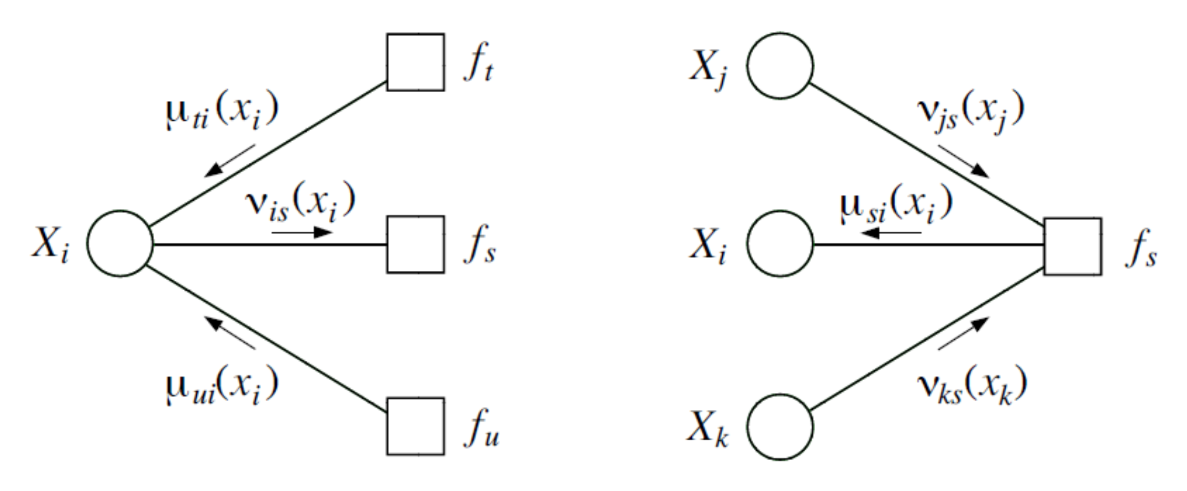
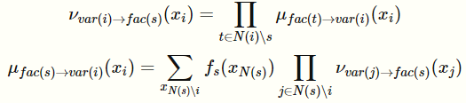
Marginal Inference – Belief Propagation¹
  Factor Graphs describe this computation more explicitly (sum-product algorithm):

Slide 17
Marginal Inference – Belief Propagation¹
  Junction Tree Algorithm works on general graphs
partitions the graph into clusters of variables
the variables within a cluster can be highly coupled
interactions among clusters must have a tree structure
at each step, each cluster marginalizes out the variables that are not in the scope of its neighbor
message passing is performed among clusters

Slide 18
Marginal Inference – Belief Propagation¹
  Loopy belief propagation:
  An approximate algorithm that discards cycles in the graph and performs message passing anyways.
  Messages are initialized uniformly.
  It continues until convergence (i.e., when messages do not change).
  Works surprisingly well in practice.

Slide 19
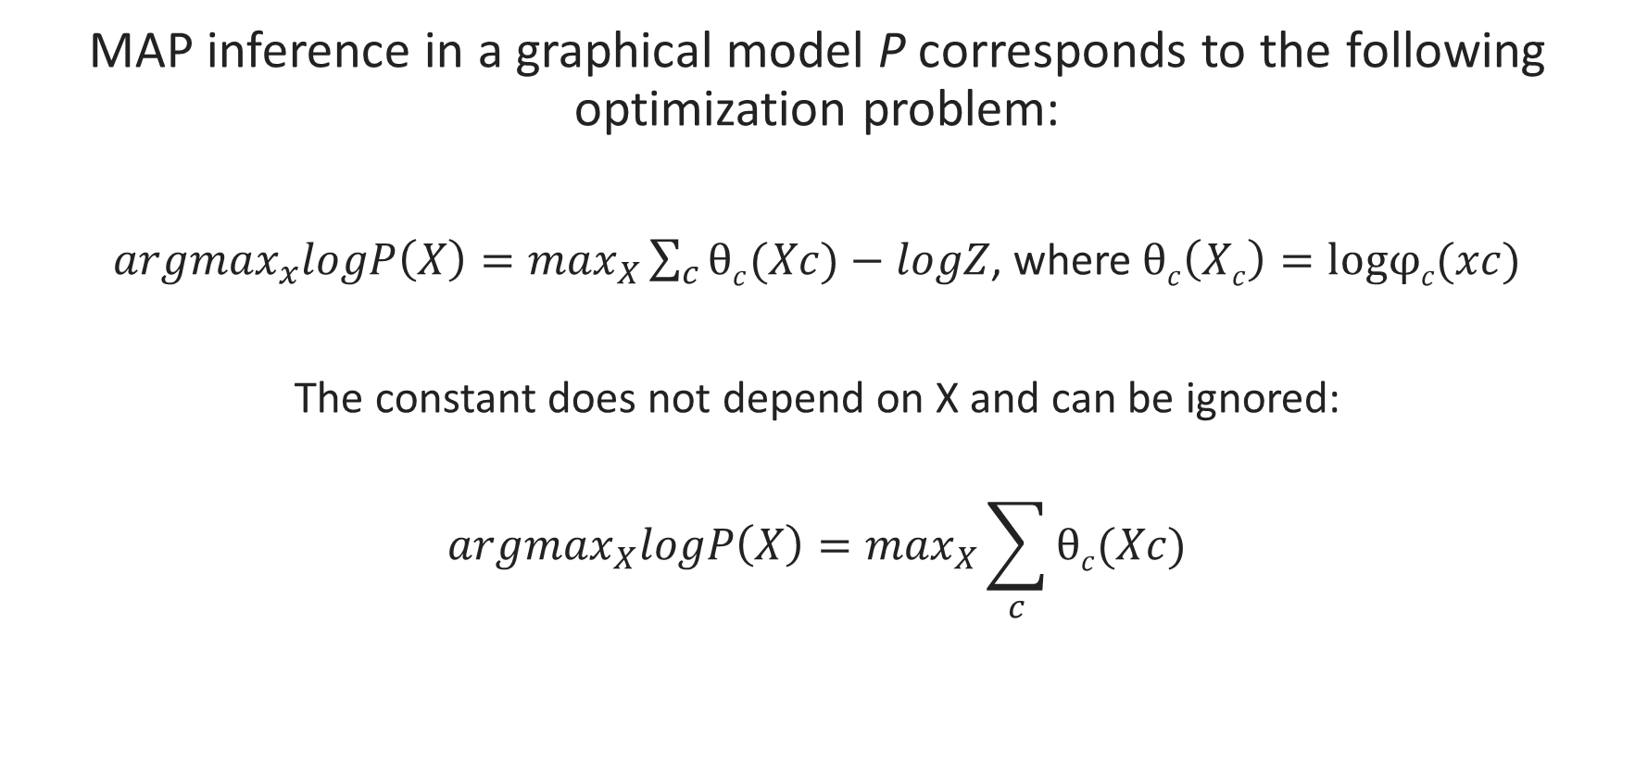
MAP Inference¹
MAP inference in a graphical model P corresponds to the following optimization problem:
${argmax}_{x}logP\left(X\right)=\max_{X}\sum_{c}{θc(Xc)}−logZ$, where$θc\left(Xc\right)=logφc(xc)$
The constant does not depend on X and can be ignored:
$${argmax}_{X}logP\left(X\right)=\max_{X}\sum_{c}{θc(Xc)}$$

Slide 20

MAP Inference¹
  Formulating MAP Inference as Mixed Integer Programming (MIP). Assume a pairwise MRF:
Introduce two indicator variables
  A variable μ_{i}(X_{i}) for each i∈ V and state X_{i}
  A variable μ_{ij}(X_{i}, X_{j}) for each edge (i, j) ∈ E and pair of states X_{i}, X_{j}
Rewrite MAP objective using those variables

Slide 21
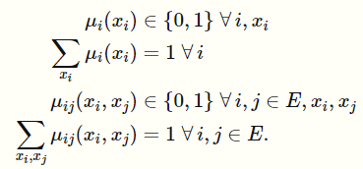
MAP Inference¹
  Formulating MAP Inference as Mixed Integer Programming (MIP). Assume a pairwise MRF:
Subject on the value constraints

Slide 22
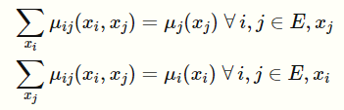
MAP Inference¹
  Formulating MAP Inference as Mixed Integer Programming (MIP). Assume a pairwise MRF:
And the consistency constraints
  Can be solved with off the self MIP solvers, such as Gurobi and CPLEX

Slide 23
MAP Inference – Message Passing¹
  By replacing sums in marginal inference with maxes, we can solve the MAP inference problem (max-product algorithm)
Typically, slower than the MIP approach
However, can be very easily built into systems that implement message passing
There exists a very effective approximate variation

Slide 24
Approximate Inference¹
  Sampling: generate samples from the multidimensional probability distribution described by the graphical model:
    Forward Sampling
    Markov Chain Monte Carlo: Metropolis – Hasting, Gibbs Sampling
    Rejection Sampling
    Importance Sampling
  Guaranteed to find a globally optimal solution given enough time
  Difficult to tell how close to the optimal solution they are within a finite amount of time
  Generally slow to converge

Slide 25
Approximate Inference¹
  Variational Inference: Given an intractable distribution P find a simpler distribution Q, that is as similar to P as possible:
  Choose a class of tractable distributions Q
  Solve an optimization problem to choose q ∈ Q which is most similar to P
    Kullback-Leibler divergence to quantity similarity among probability distributions
  Will almost never find a globally optimal solution
  May produce bounds on their accuracy
  Scales better
  Can leverage state of the art computation techniques
    Stochastic gradient optimization
    Acceleration using GPUs
    Parallelization

Slide 26
Learning

Slide 27
Learning¹
  Given a dataset, we would like to fit (train) a model that will make useful predictions on various tasks that we care about:
  Parameter learning: the graph structure is known, and we want to estimate the factors/parameters/potential functions.
  Structure learning: we want to estimate the graph, i.e., determine from data how the variables depend on each other

Slide 28
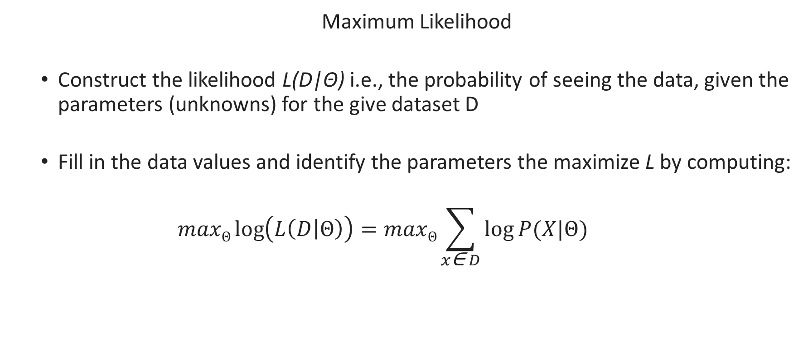
Learning – Directed Graphical Models¹
  Maximum Likelihood
  Construct the likelihood L(D|Θ) i.e., the probability of seeing the data, given the parameters (unknowns) for the give dataset D
  Fill in the data values and identify the parameters the maximize L by computing:
  $$maxΘ\log\left(L\left(D | Θ\right)\right)=maxΘ\sum_{x\text{∈} D}{\log{P(X|Θ)}}$$

Slide 29
Learning – Undirected Graphical Models¹
  Analytically solving maximum likelihood is usually expensive because of the normalization constant
  Approximate methods:
    Gradient descend
      employ sampling to approximate gradient
      contrastive divergence to decrease the required sampling steps
    Pseudo-likelihood: compute likelihood of a subset of variables, assuming the values of the rest of the variables are fixed

Slide 30
Learning – Latent Variable Models¹
  Expectation Maximization
  Relies on two simple assumptions:
  If the latent variable Z were fully observed, then we could optimize the log-likelihood exactly as previously
  Knowing the weights, we can often efficiently compute the posterior P(Z∣X; θ)

Slide 31

Learning – Latent Variable Models¹
  Expectation Maximization
  Given a dataset D:
  Starting at an initial θ₀, repeat until convergence for t = 1, 2, …:
    E-Step: For each X ∈ D, compute the posterior p(Z | X; θ_{t})
    M-Step: compute new weights via:

Slide 32
Learning¹
  Structure Learning for Bayesian Networks
  score-based approach
    defines a criterion to evaluate how well the Bayesian network fits the data
      penalized log likelihood
    searches over the space of DAGs for a structure with maximal score
      local search
      greedy search
  constraint-based search
    employs the independence test to identify a set of edge constraints for the graph
    finds the best DAG that satisfies the constraints
  order-search: searches only over the graphs that obey a chosen topological order
  MIP-based: encodes graph structure, scoring and acyclic constraints into an MIP problem

Slide 33
References
https://cs.stanford.edu/~ermon/cs228/index.html
http://ftp.mi.fu-berlin.de/pub/bkeller/MatLab/Examples/bayes/lungbayesdemo.html
A. Radford, L. Metz and S. Chintala: Unsupervised Representation Learning with Deep Convolutional Generative Adversarial Networks, ICLR 2016
D. Aronsky and P. J. Haug: Diagnosing community-acquired pneumonia with a Bayesian network, Proc. AMIA Symposium 1998
Y. Ni, P. Müller, L. Wei and Y. Ji: Bayesian graphical models for computational network biology, BMC Bioinformatics 63(2018)
J. A. Bilmes: Graphical Models and Automatic Speech Recognition, The Journal of the Acoustical Society of America, 2011
W.-N. Hsu, Y. Zhang, R. J. Weiss, H. Zen, Y. Wu, Y. Wang, Y. Cao, Y. Jia, Z. Chen, J. Shen, P. Nguyen and R Pang: Hierarchical Generative Modeling for Controllable Speech Synthesis, ICLR 2019
W. Ping and A.T. Ihler: Belief Propagation in conditional RBMS for structured prediction, AISTATS 2017
https://www.mpi-inf.mpg.de/fileadmin/inf/d2/GM/2016/gm-2016-1213-imageprocessing.pdf
D. P. Kingma and M. Welling : An Introduction to Variational Autoencoders, Foundations and Trends in Machine Learning: Vol. 12 (2019)

